Slide 1

Frances Larder (MPhil)

Slide 2
Revenge
War is War, no doubt about it—a constant cycle of man’s evil towards man.
A tree’s branches don’t move of their own accord; something has to move them.
Likewise, men don’t simply turn into savages; There has to be something that makes them that way.
And men then go on to make weapons to kill their enemies, because there are enemies everywhere.
So very few stop to realise that their most important foe is themselves, that therein the seeds of savagery lie.
Extract from a story by Pramoeda Ananta Toer (1925-2006)
Indonesian writer and social critic

Slide 3
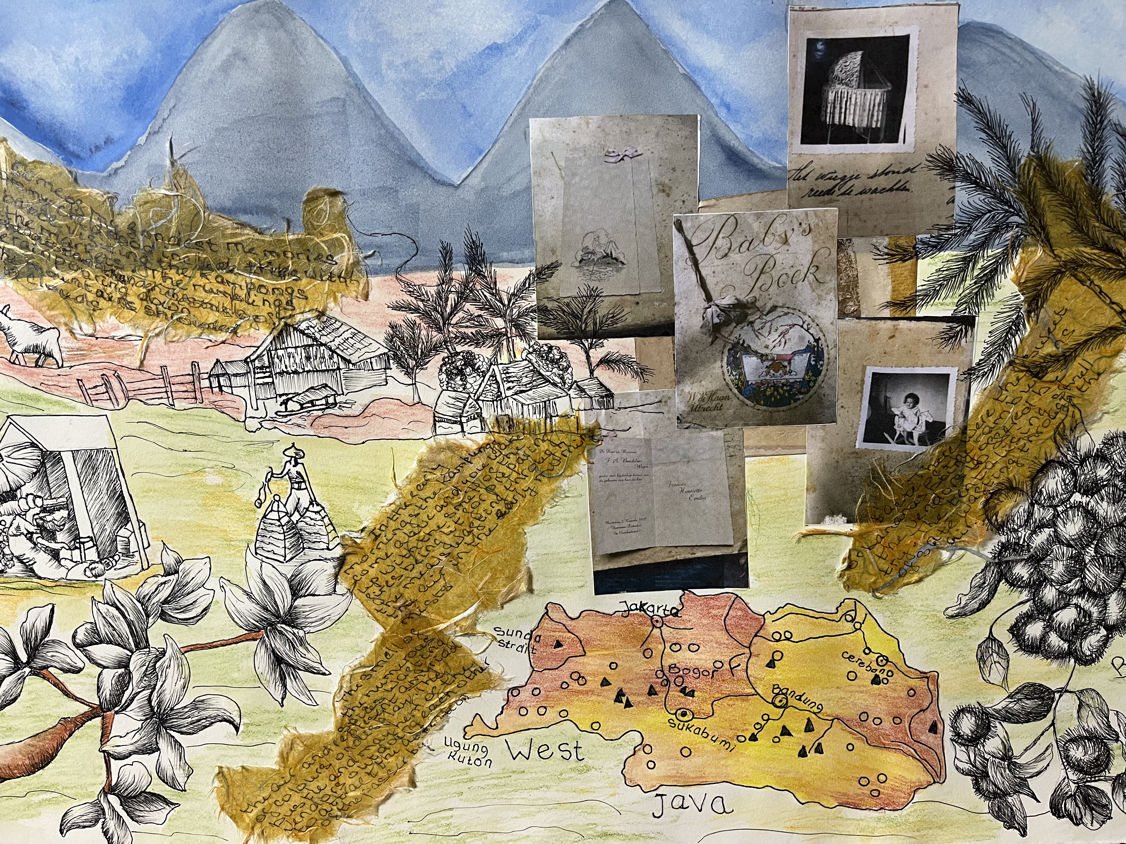
“Netherlands East Indies”

Slide 4
“Landscape of the Soul - Childhood Memories”

Slide 5
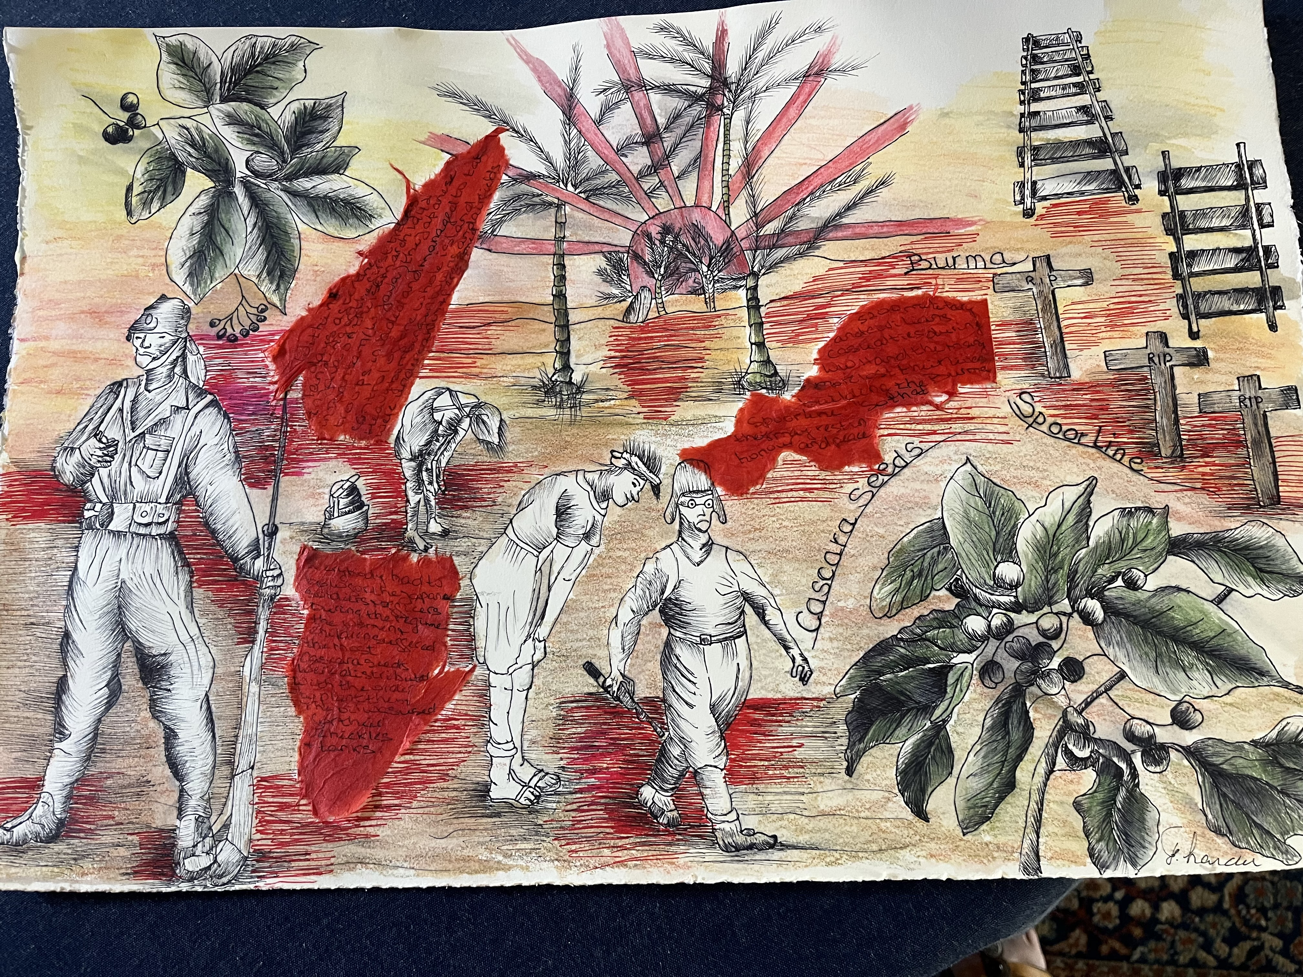
“Japanese Invasion”

Slide 6
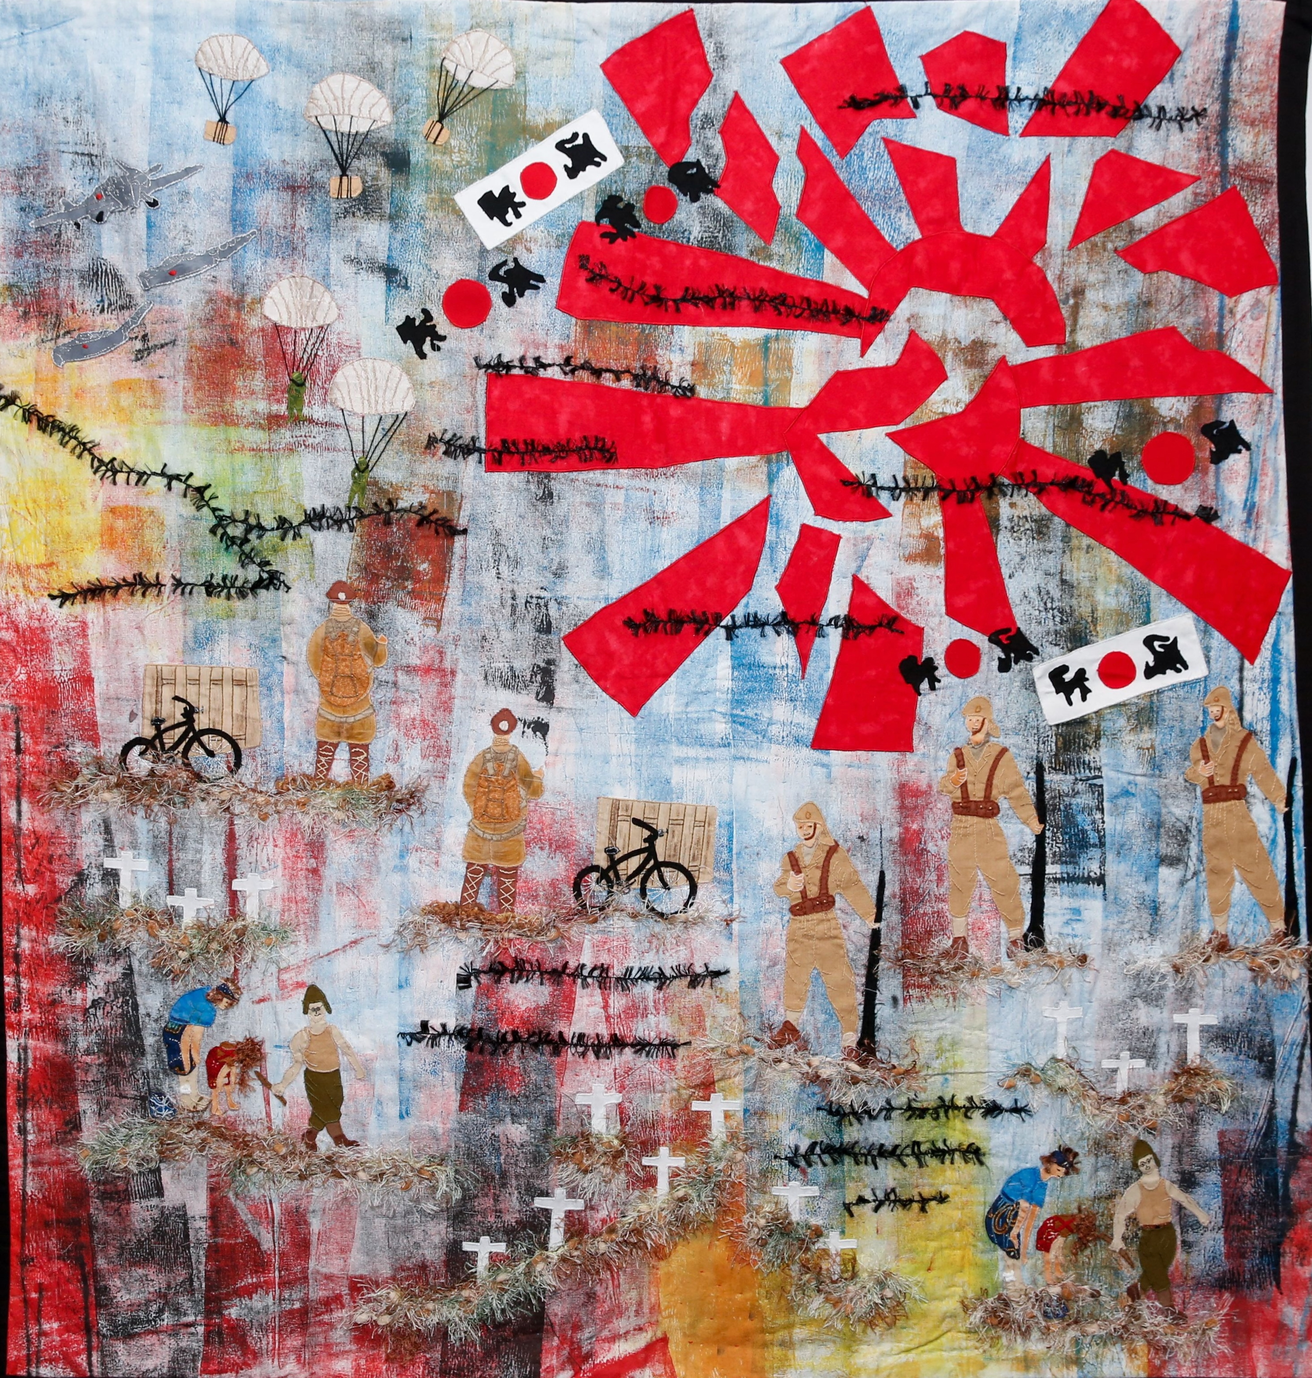
“World War II”

Slide 7
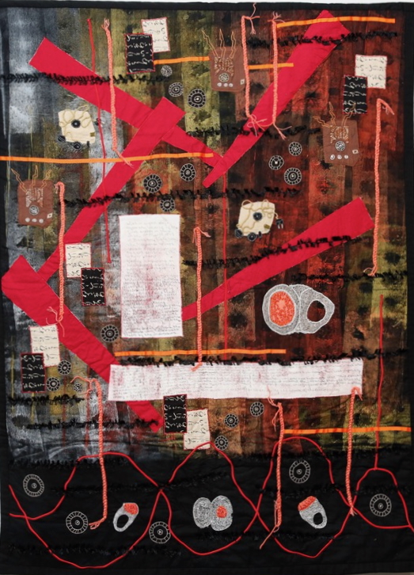
“The Ring”

Slide 8
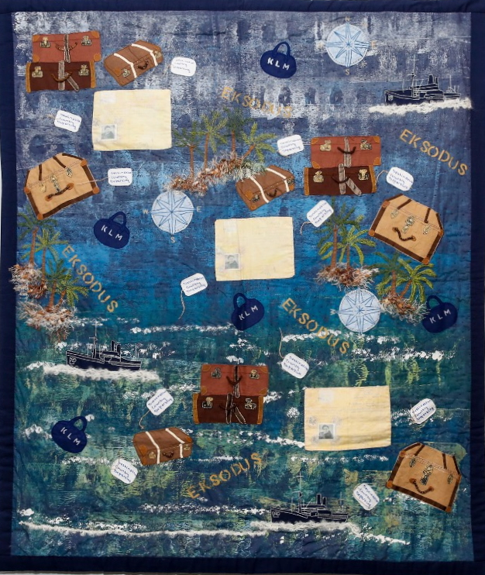
“Exodus”

Slide 9
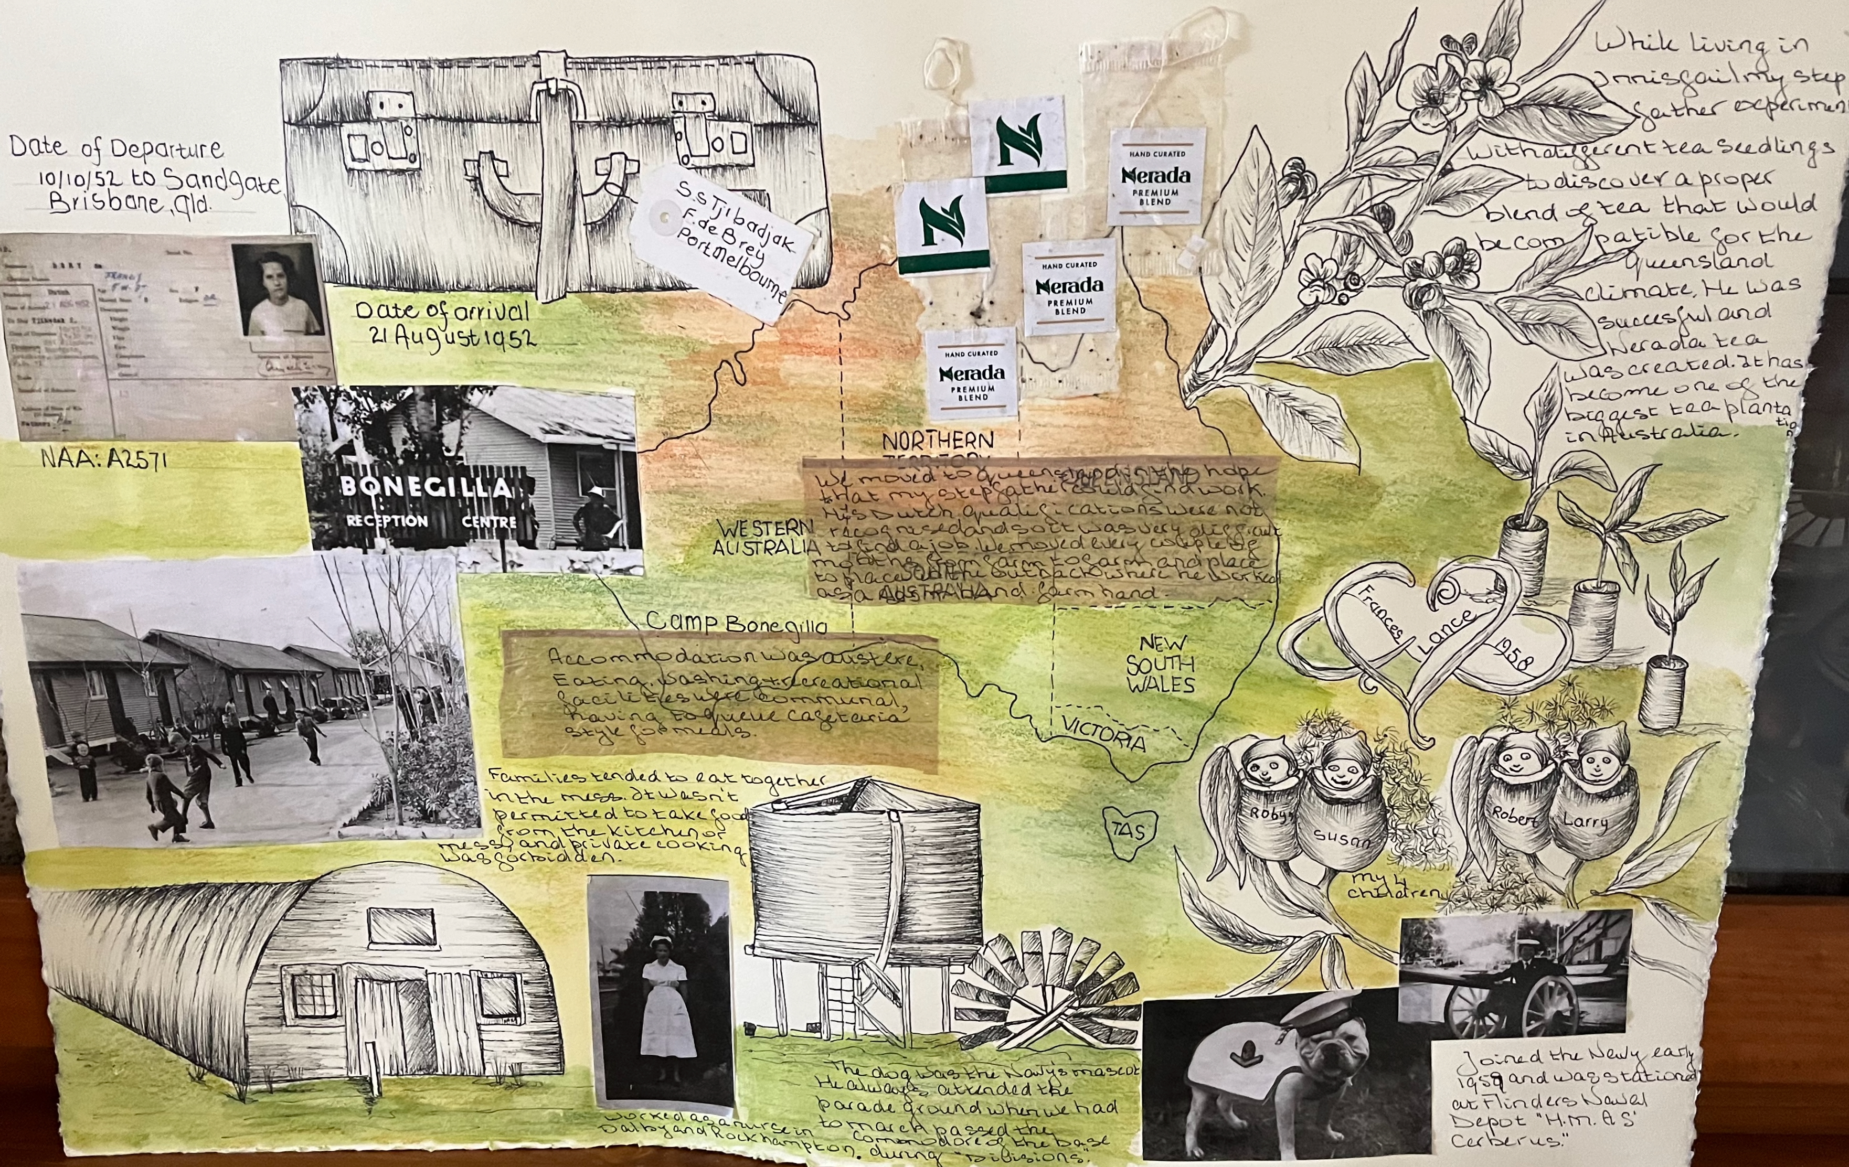
“The voyage to Australia”

Slide 10
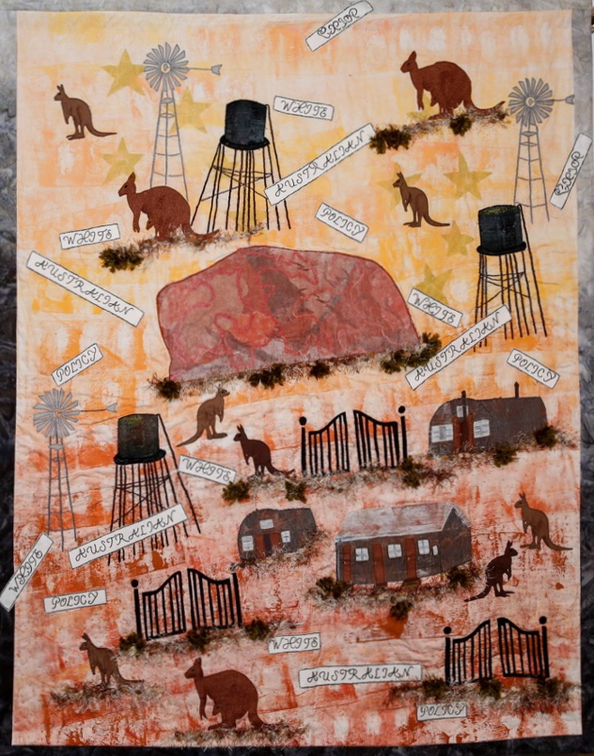
“A New Beginning”

Slide 11
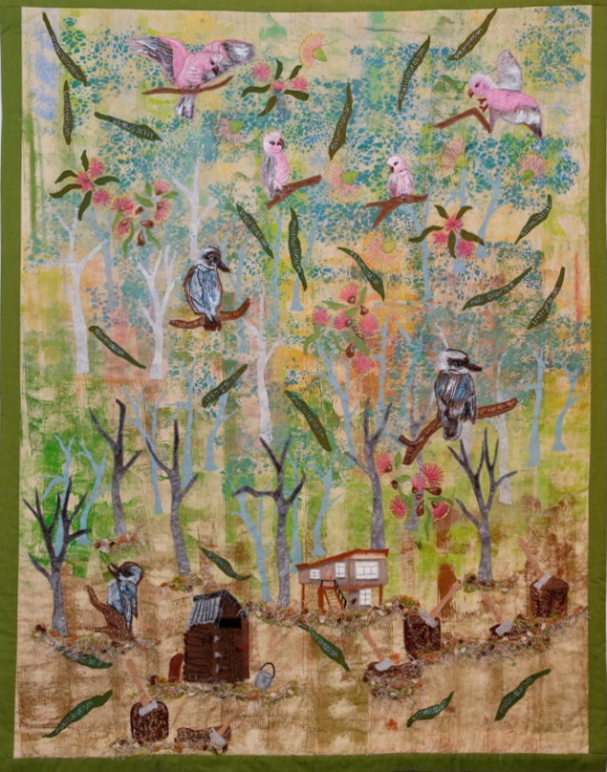
”Life among the Gum trees”

