Slide 1
SNAPSHOTS OF FAIRBRIDGE FARM SCHOOL GOES DUTCH November 1945 to July 1946
The rehabilitation in Western Australia of Dutch
children from the Netherlands East Indies
interned by the Japanese occupiers,
April 1942 to November 1945.

Slide 2
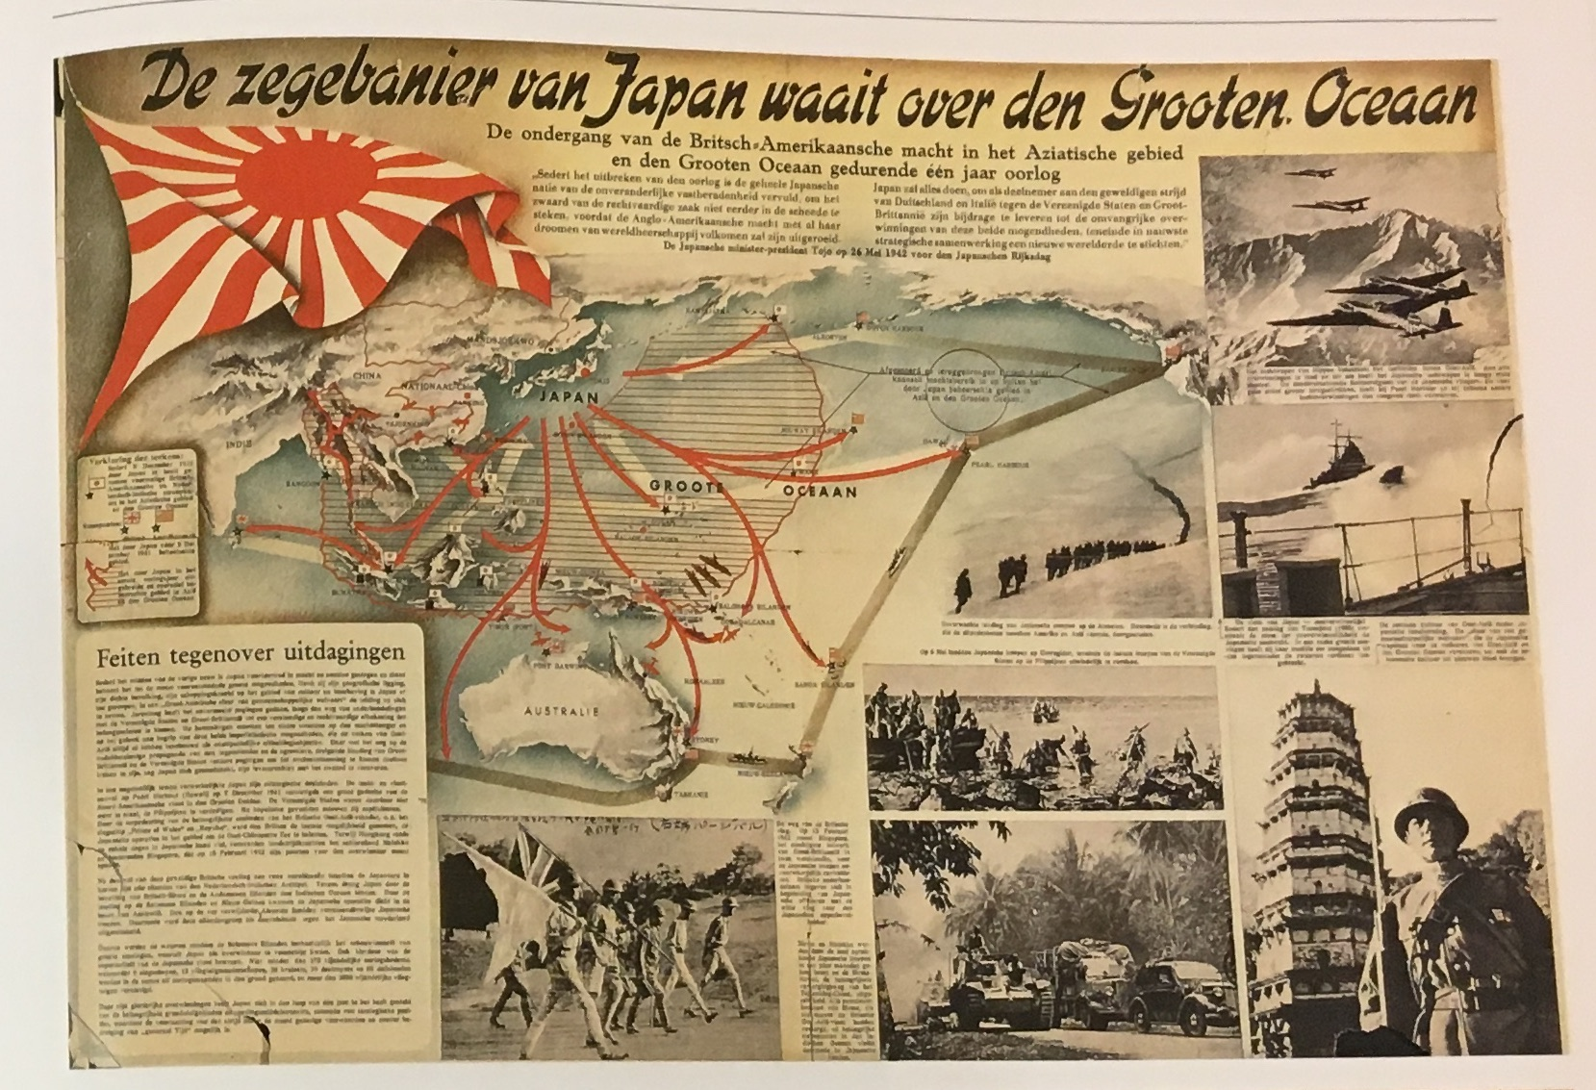
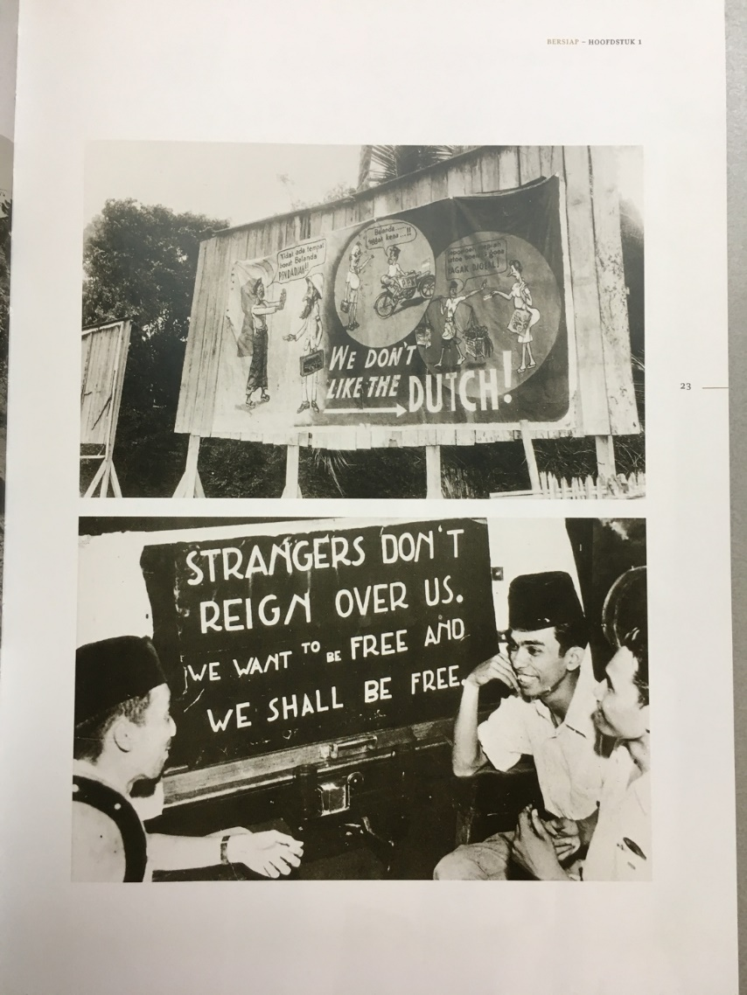
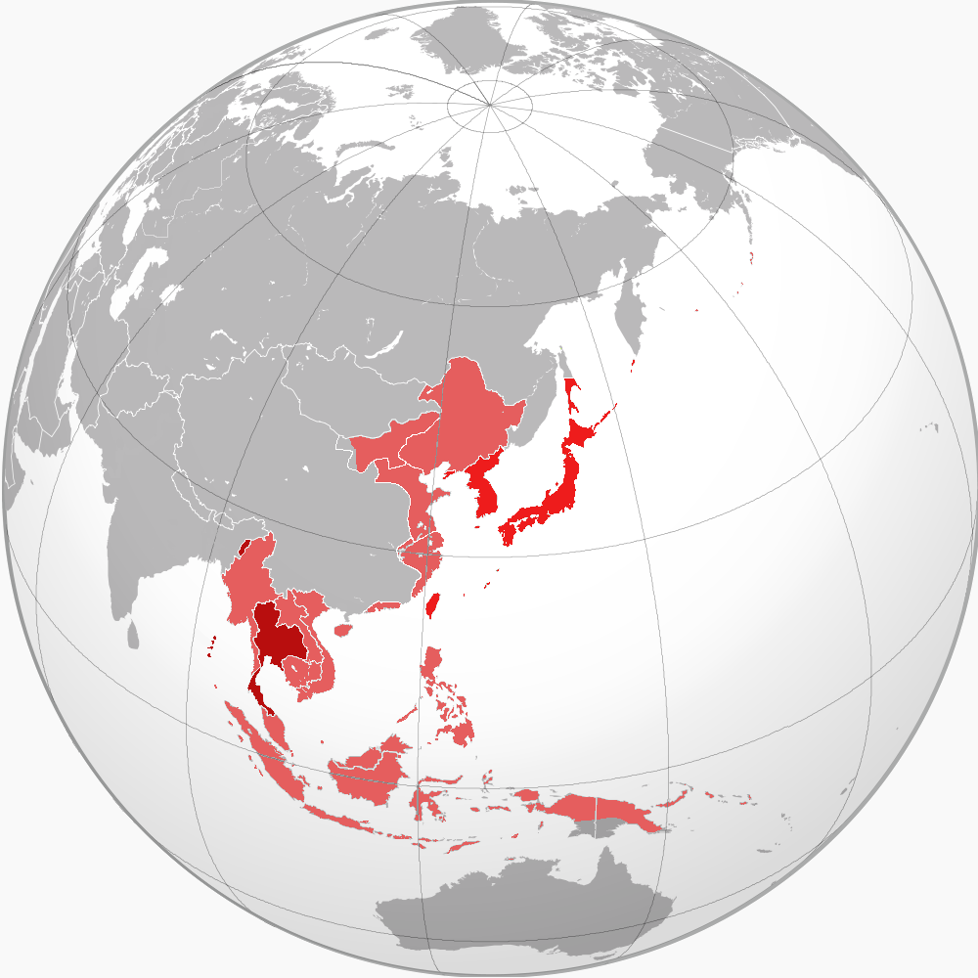
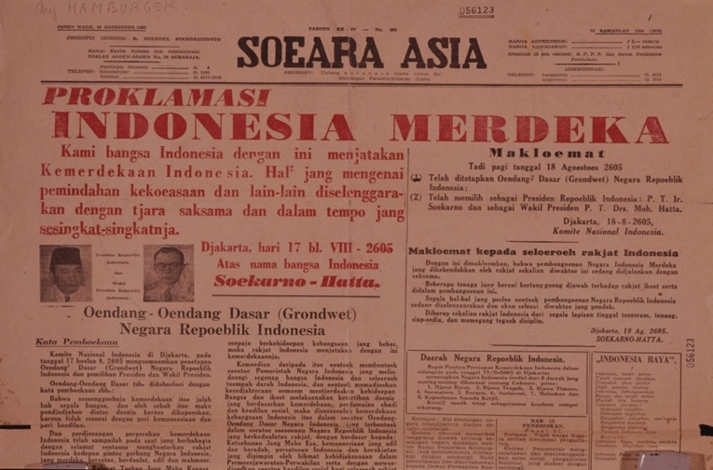
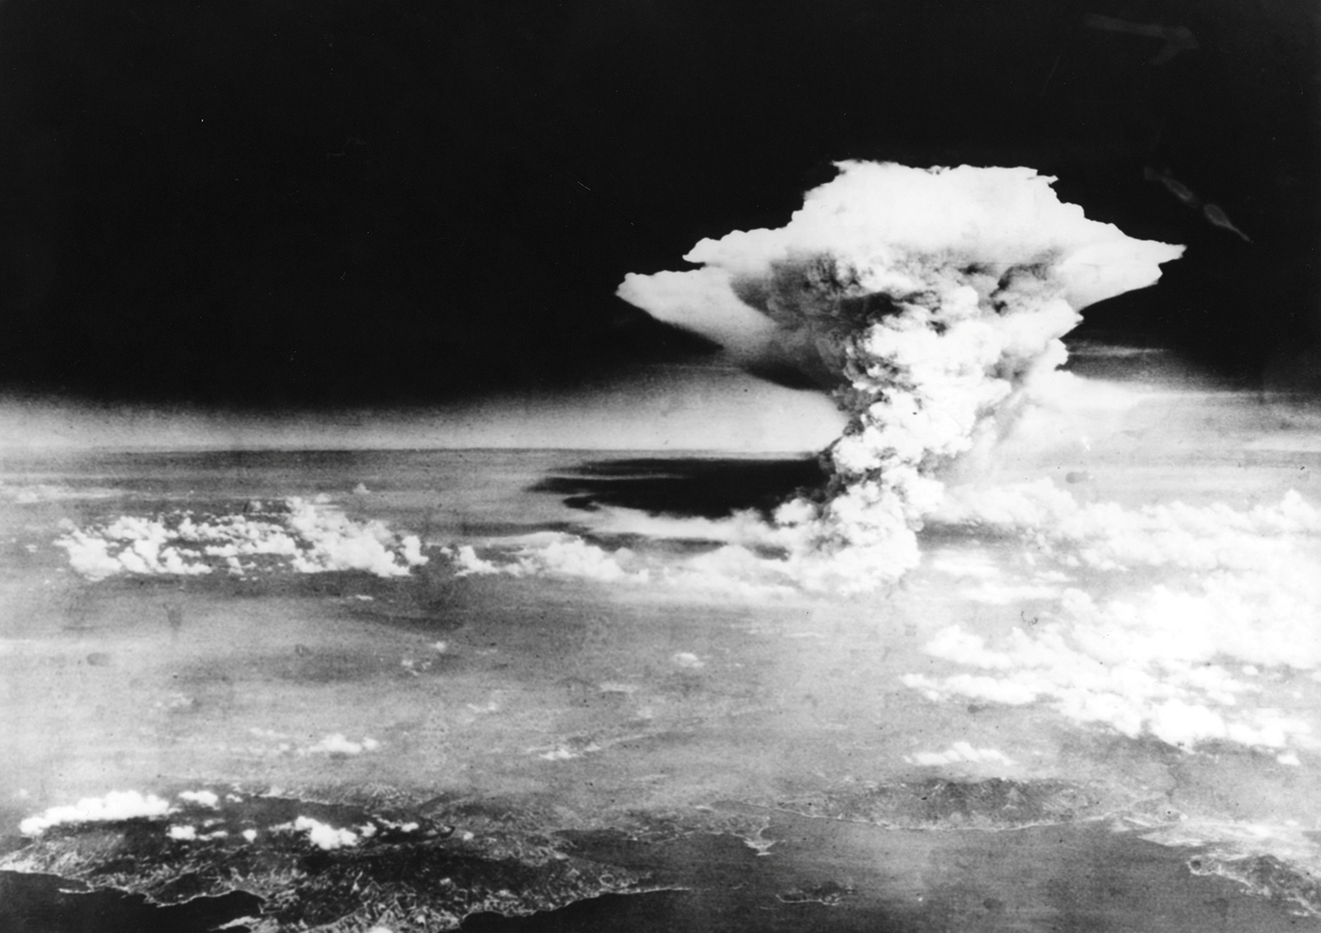
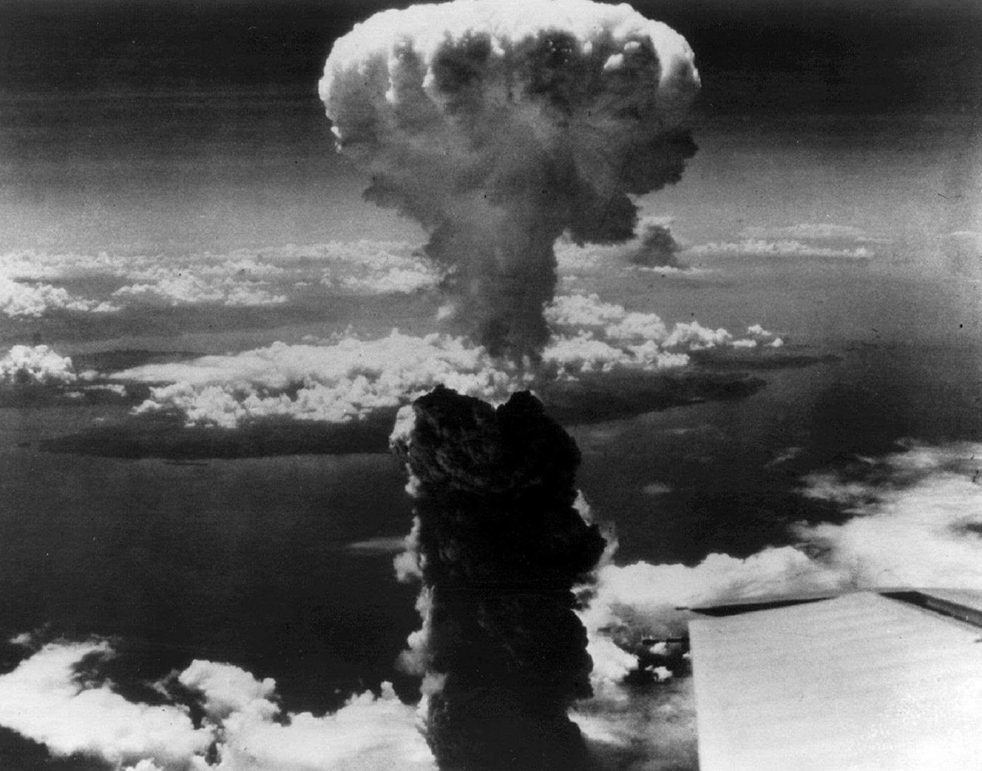
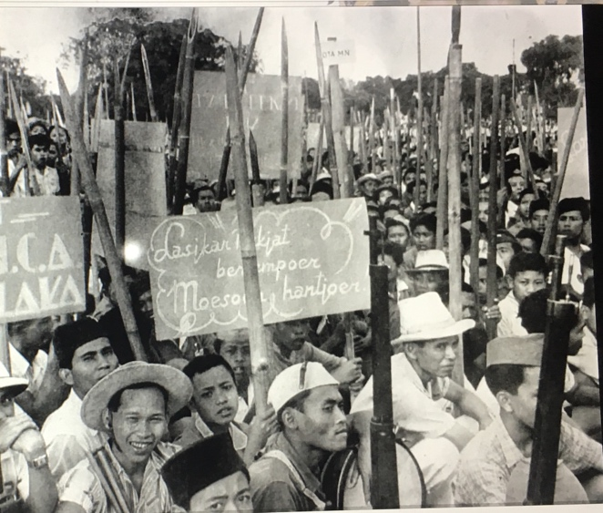
Historical background : WWII Asia Pacific, NEI capitulation, Japanese occupation, nuclear bombing, Japan capitulates, Indonesian revolution for Independence, rehabilitation at Fairbridge Farm School, Pinjarra WA.
Hiroshima August 6, Nagasaki August 9, 1945
Notes:
https://www.niod.nl/en/frequently-asked-questions/japanese-occupation-and-pacific-war-numbers

Slide 3
Inmates in Japanese POW and civilian internment camps were not told of Japan’s capitulation until 23 August. Concurrently, they were told to stay put, to wait for the team of Recovery of Allied Prisoners of War and Internees (RAPWI) to assess them. Also to stay out of the escalating independence fray. All POWs and interned were severely depleted & needed urgent physical and/or trauma medical care. All had to be registered. None had identity documents. Their homes, goods and chattels purloined by others. They had nowhere to go. Under the terms of surrender, their Japanese oppressors were commanded to be their carers until South East Asia Command (SEAC) arrived 6 weeks later. All say it was bizarre! However, food rations increased overnight!

Slide 4
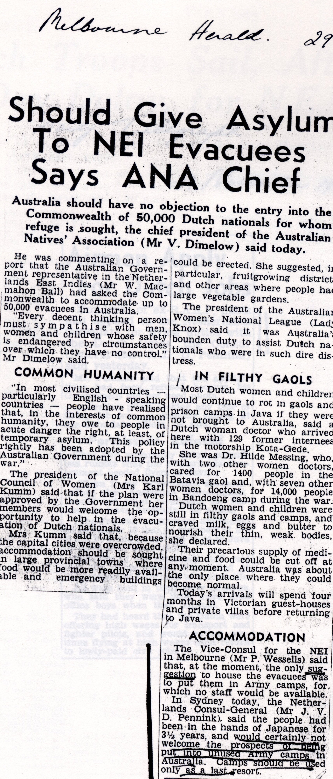
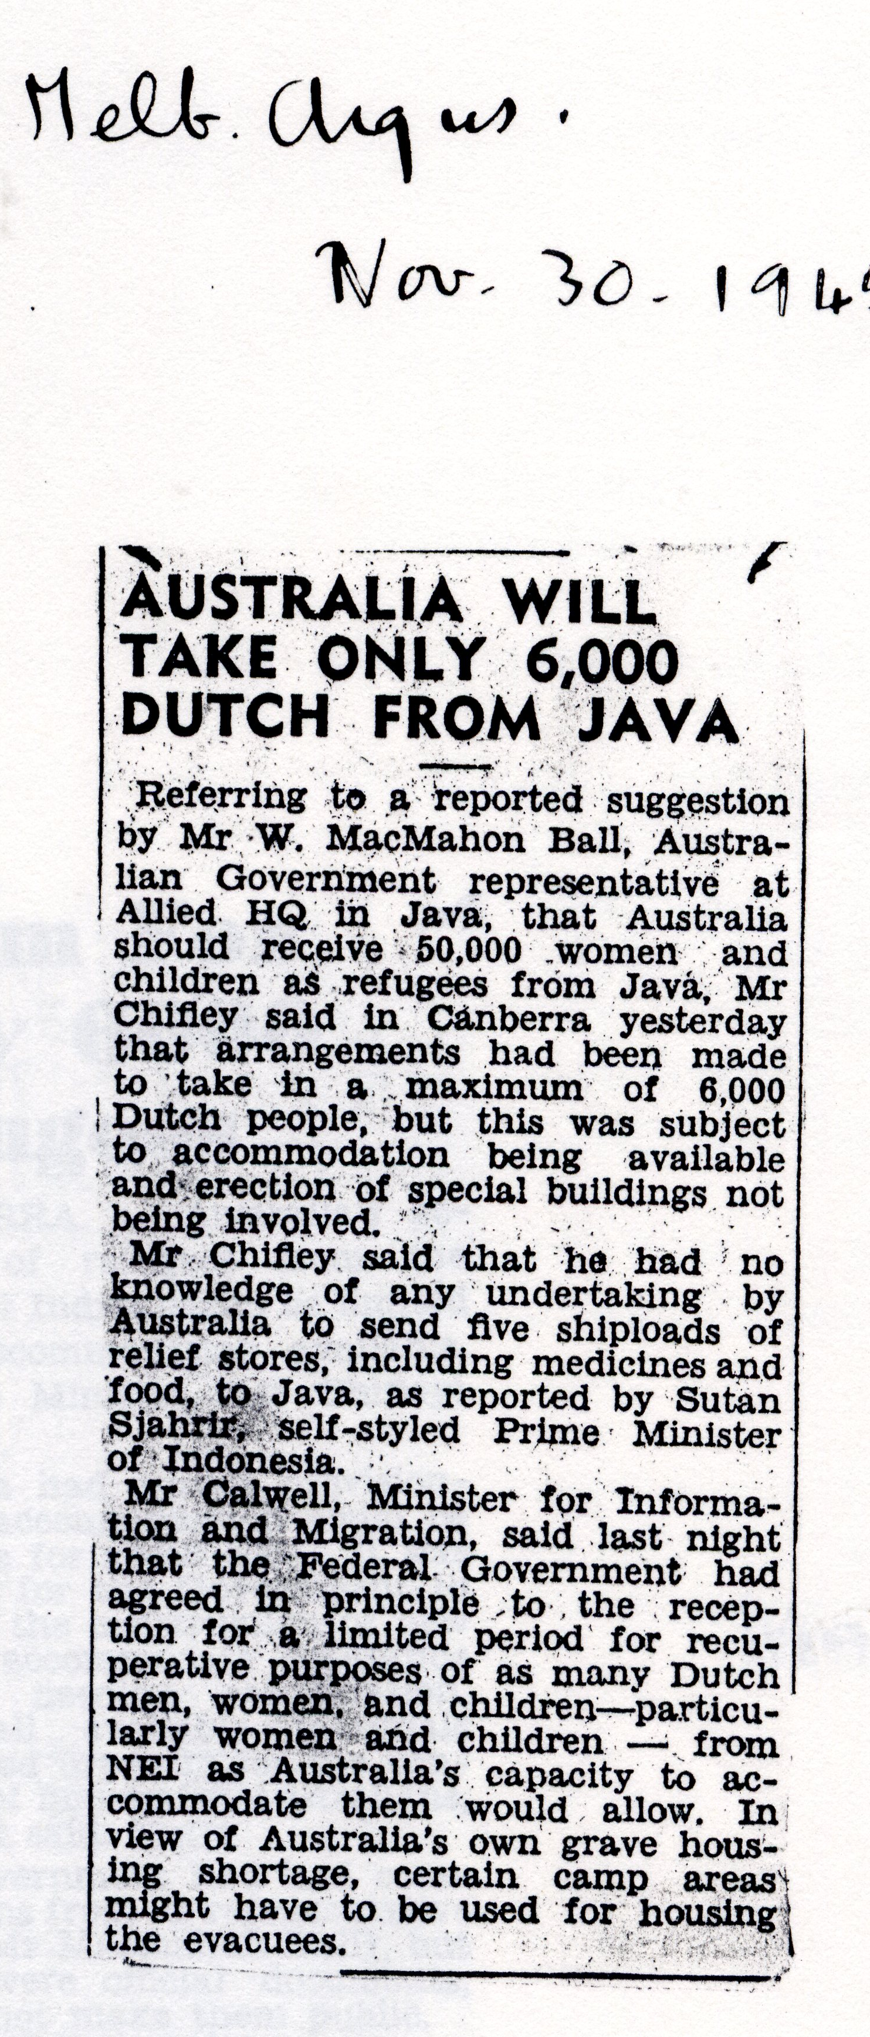
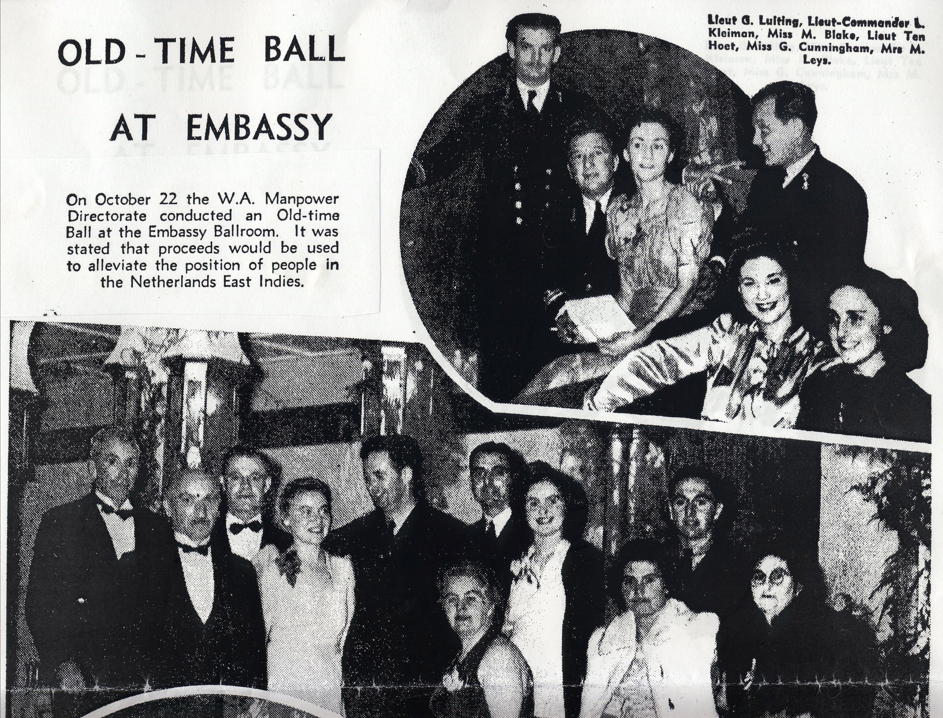
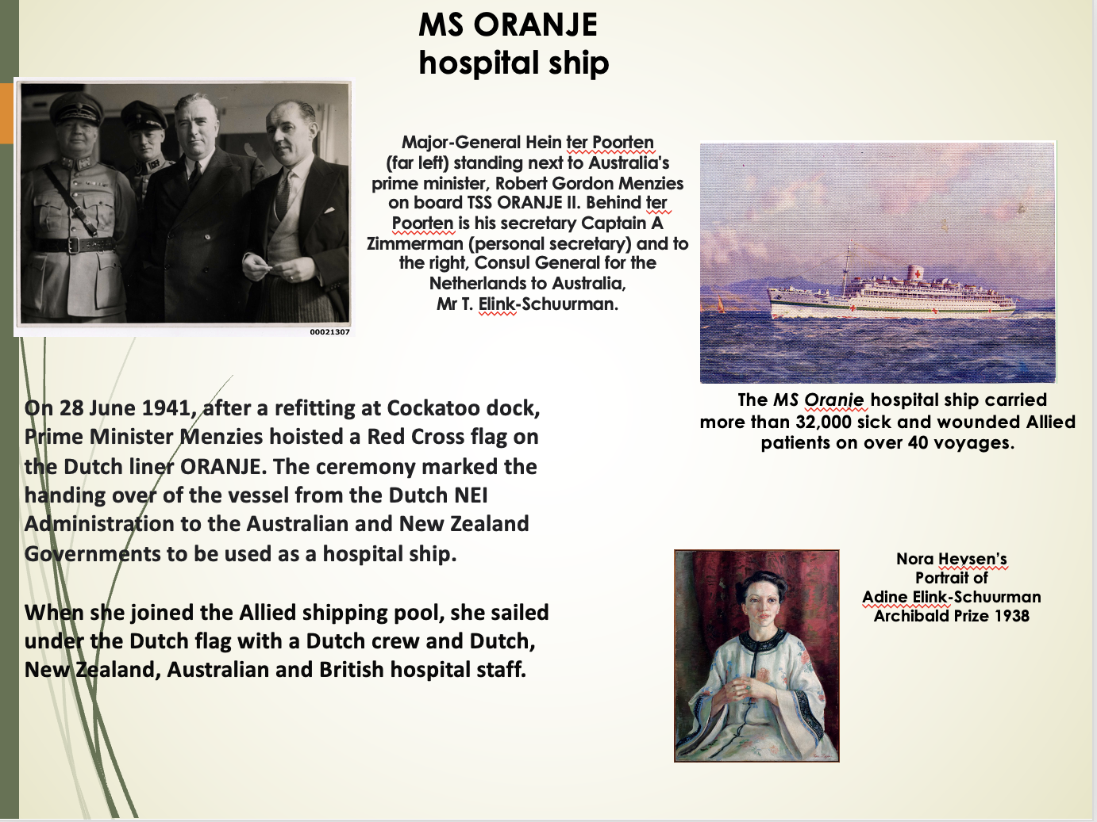
Australia steps up?

Slide 5
ARRIVAL IN FREMANTLE
For twenty-year-old Nora Lumkeman, selected for evacuation by her urgent need for medical attention, the experience of arrival in WA was almost too good to be true. She explains:
“On arrival in Fremantle where the Waterside Workers Union strike was in progress, so no barges to help the SS Oranje berth.
I was put on a stretcher on the quay. I was still very ill from djarak seed poisoning. My first meeting with an Australian was emotional. A man who looked like a beggar approached me and offered a little bag of candies. I will never forget this moment.
We were soon taken by ambulance to Perth’s Westminster hospital. [Some time later, being on the mend, we were allowed to sit in the garden, and I remember clearly both a girlfriend and I pinching our arms to feel that we were really awake and not just dreaming a sweet dream.”
Westministrer Hospital

Slide 6
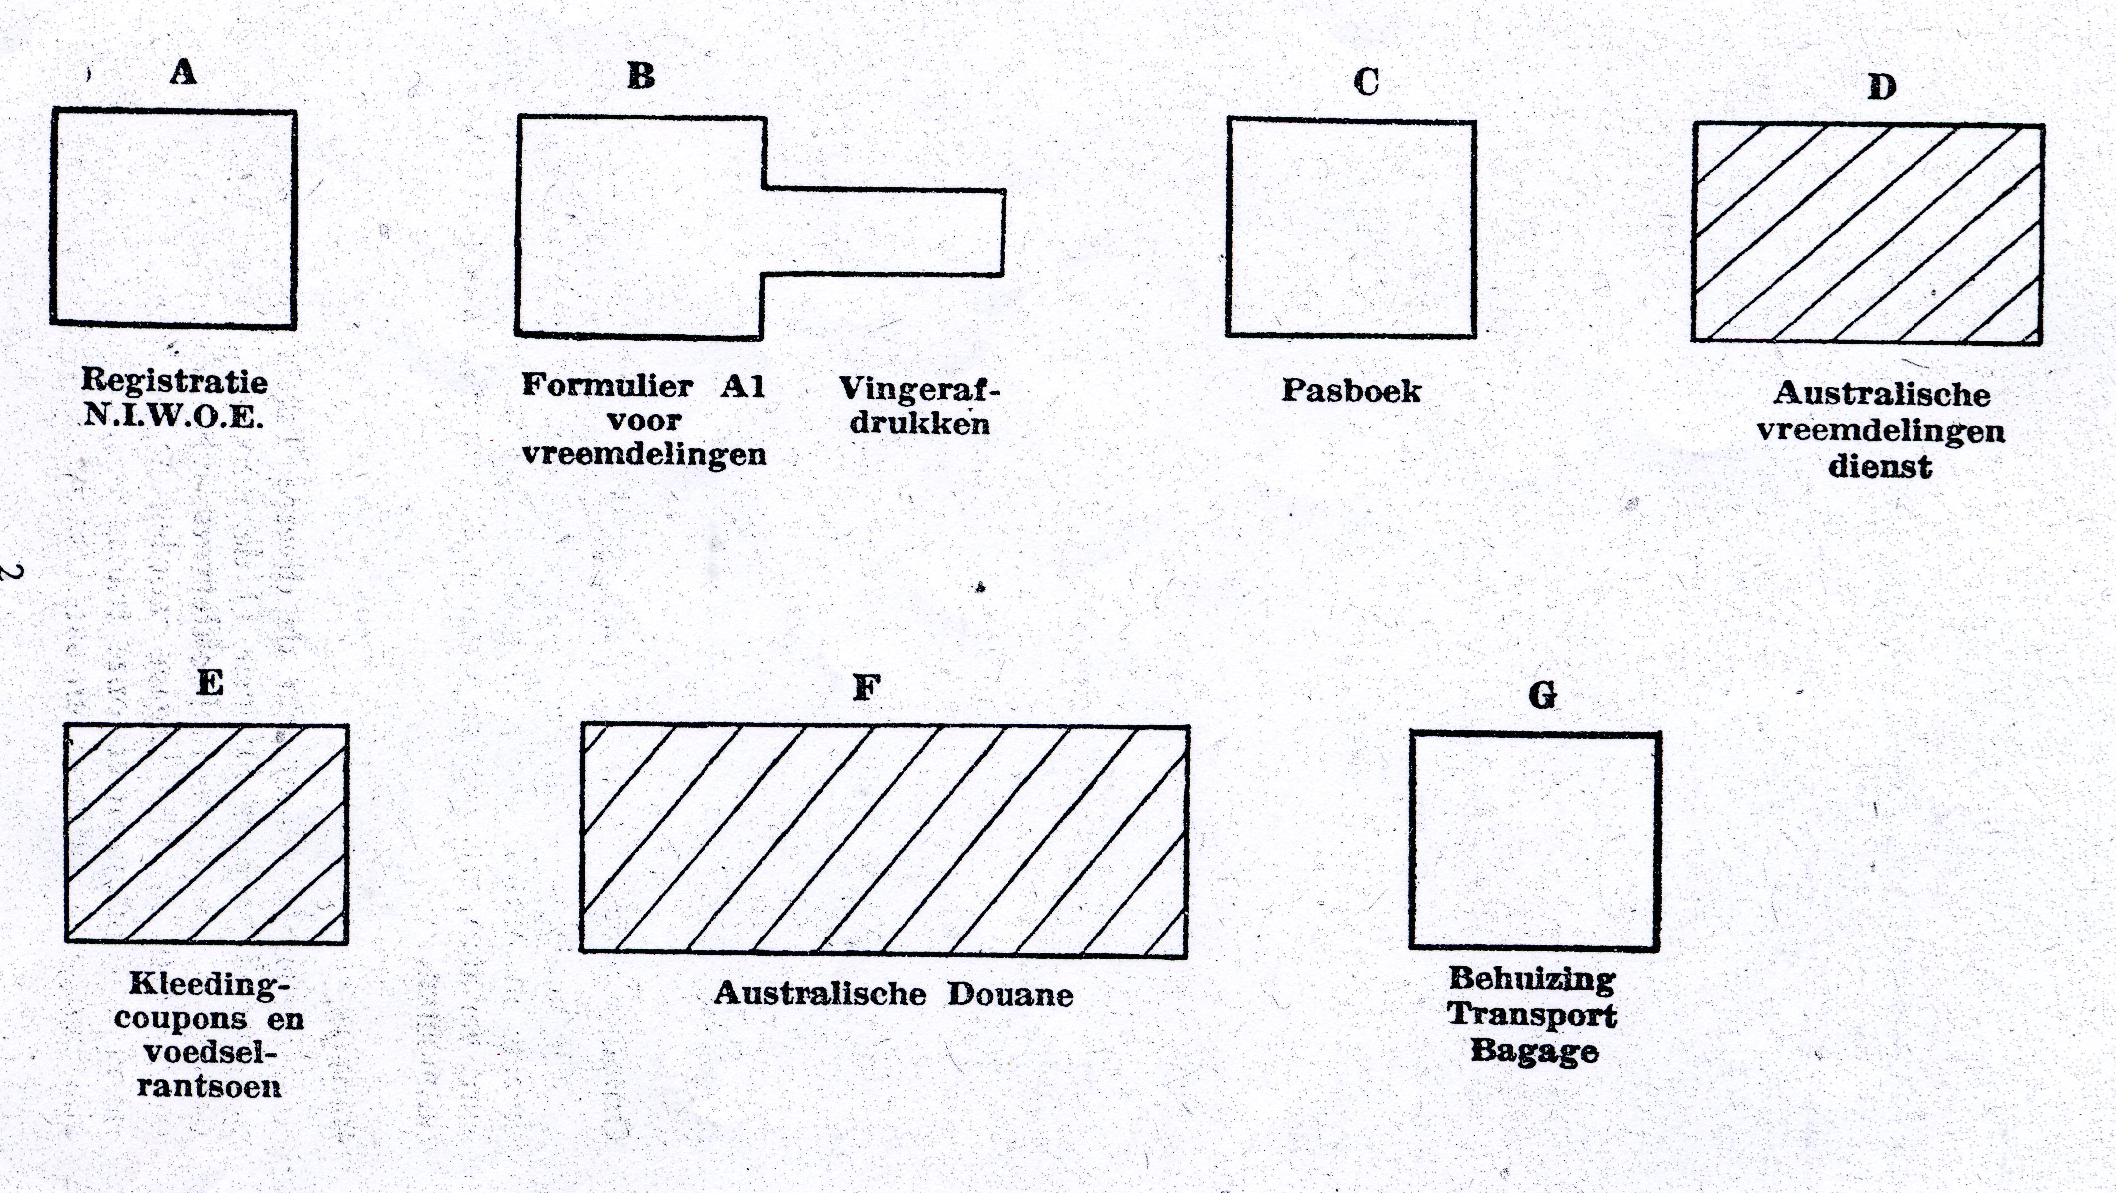
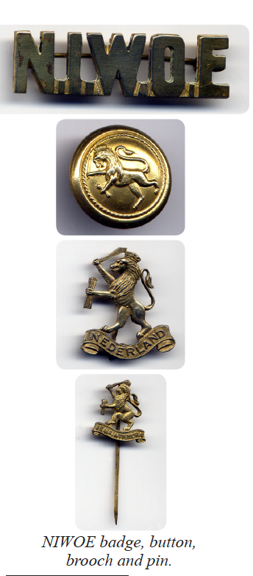
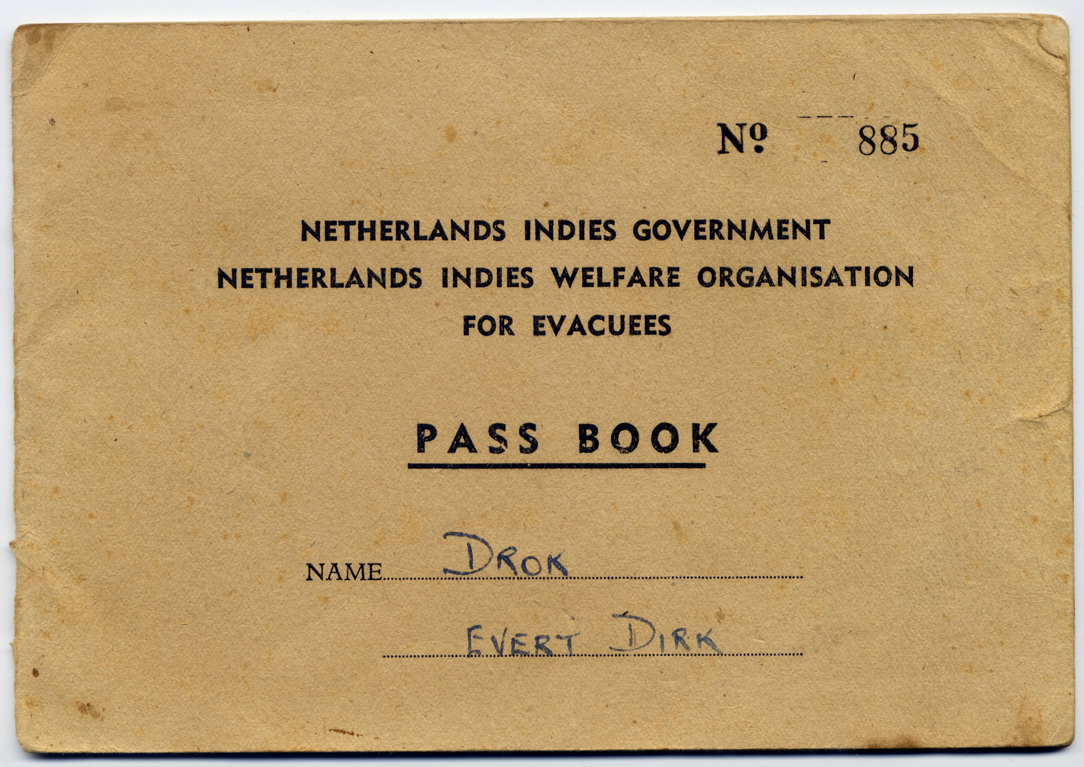
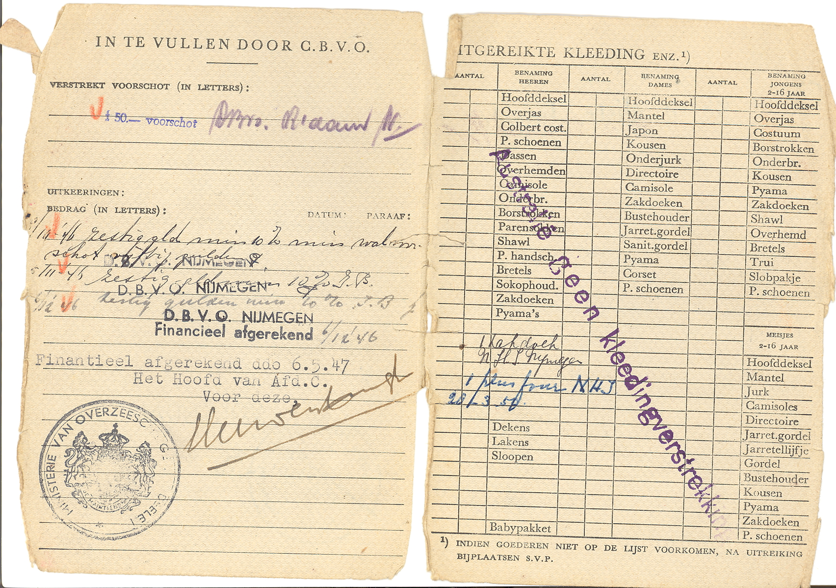
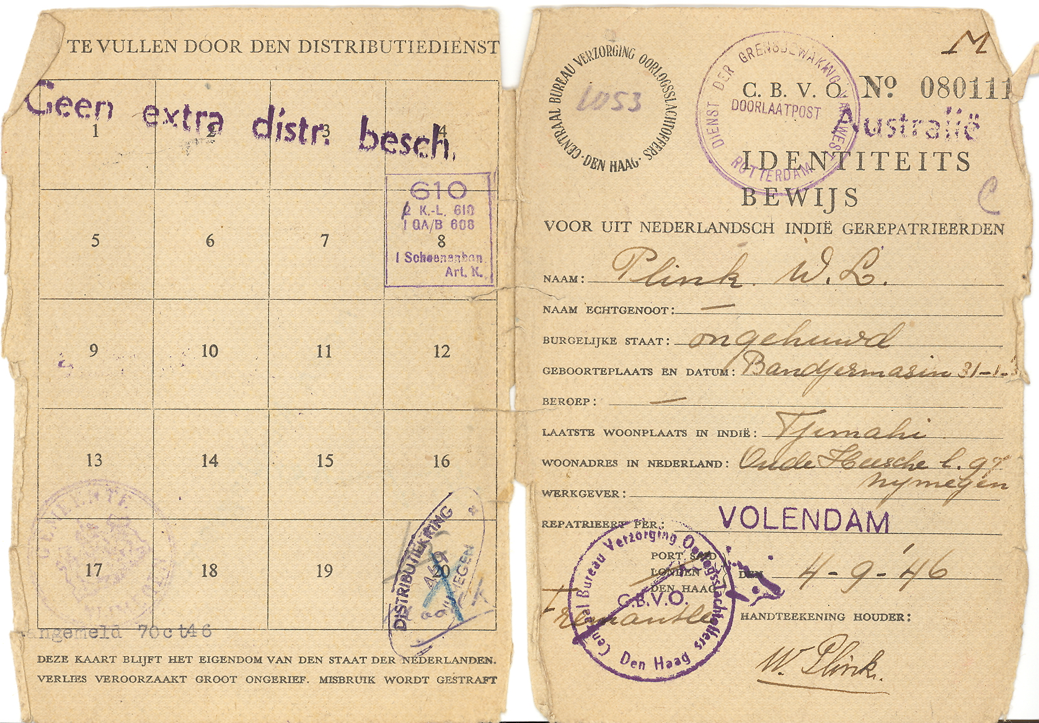
Processing Refugees
NIWOE: Processing format of refugees without documentation

Slide 7
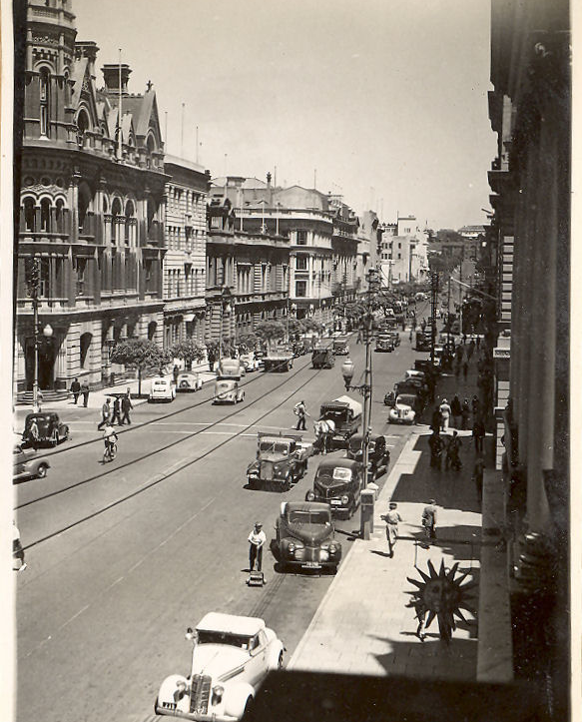
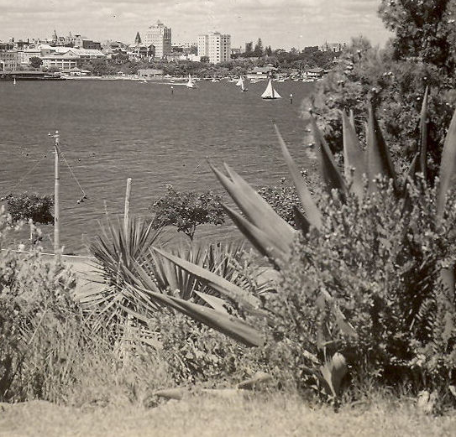
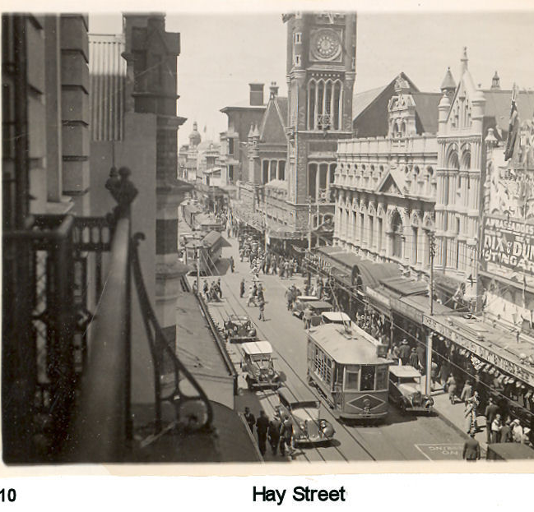

Slide 8
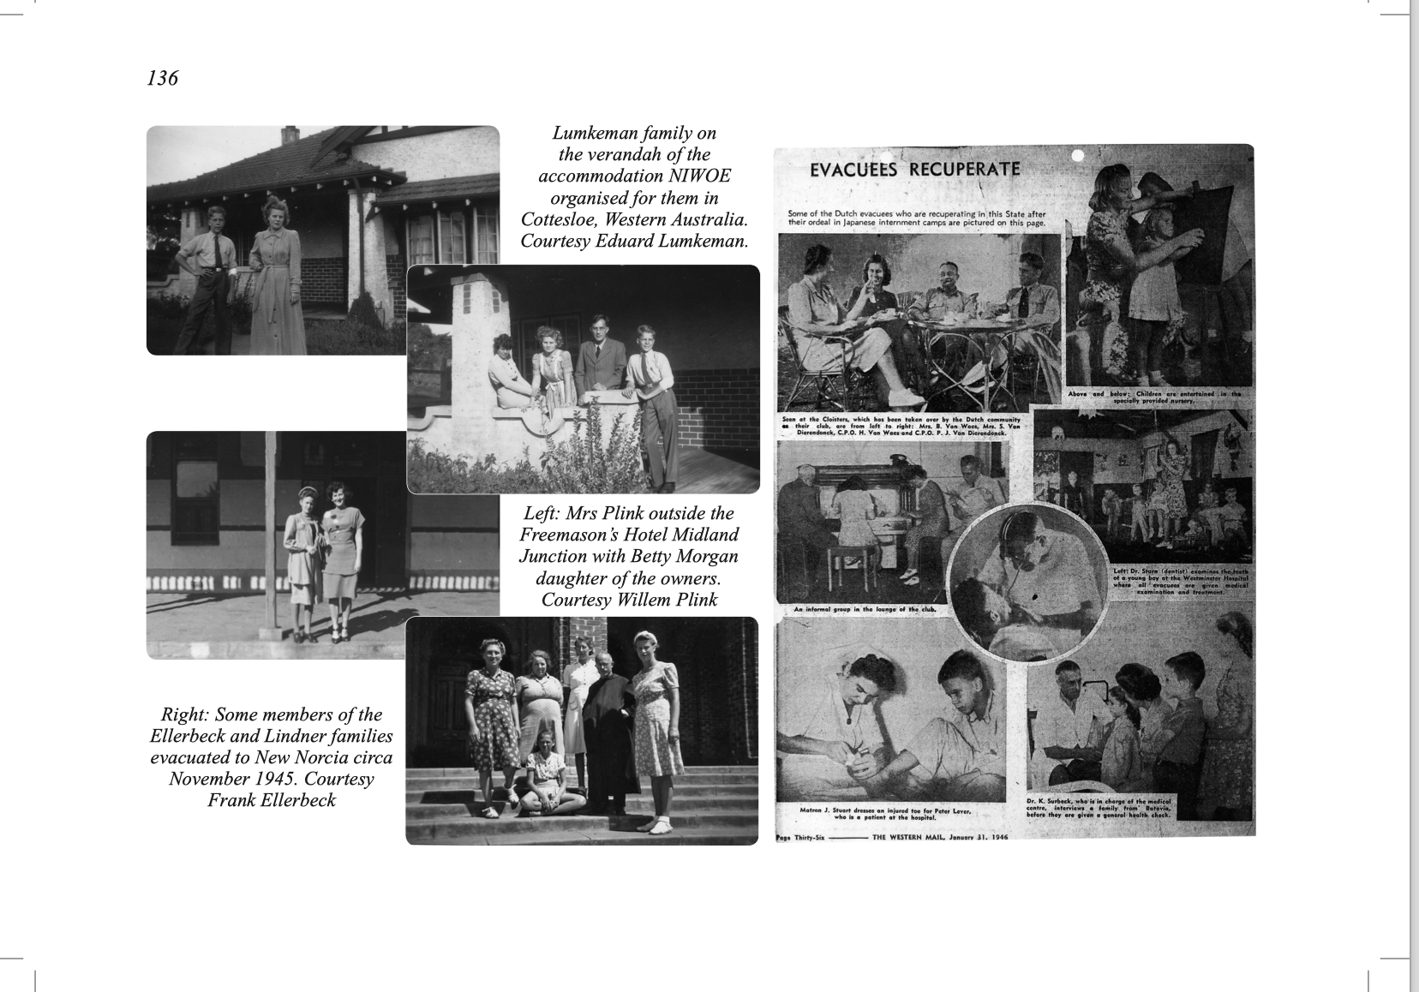
NIWOE sought accommodation for evacuees.
Westminster hospital provided health and dental care.

Slide 9
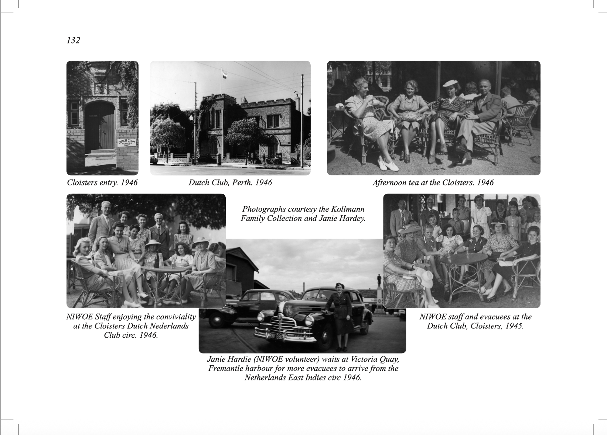
In 1945, ‘The Cloisters’, a two-story, dark-coloured brick building originally a secondary boys' school in the 1850s, became the Dutch Club.

Slide 10
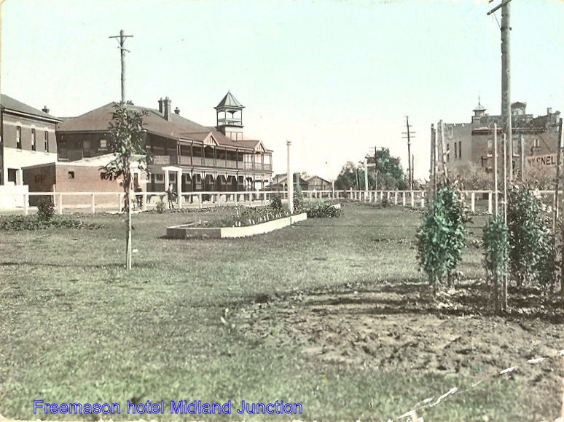
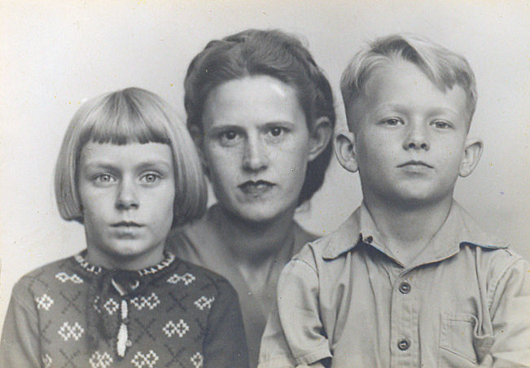
Refugee accommodation at the Freemasons Hotel, Midland
The Plink Family:
Mrs Plink was sent for rehabilitation to deal with the deaths of her husband, brother and father.

Slide 11
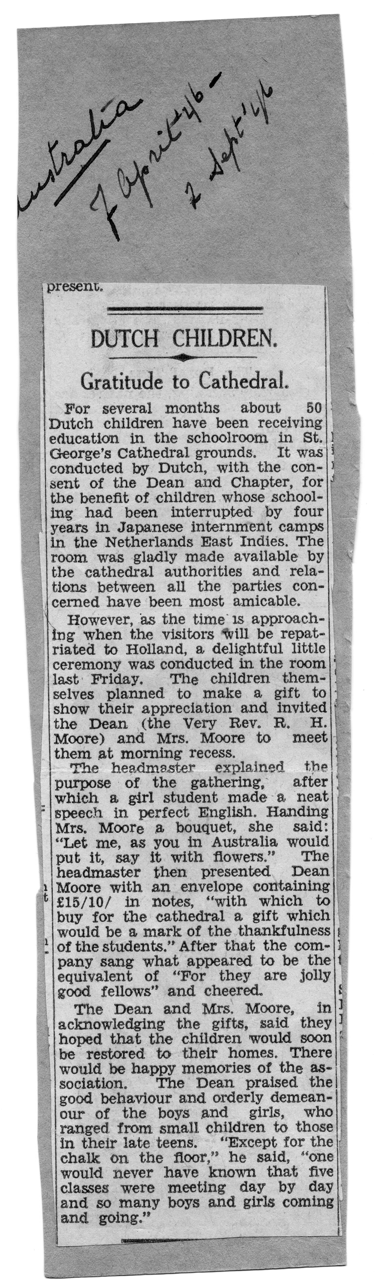
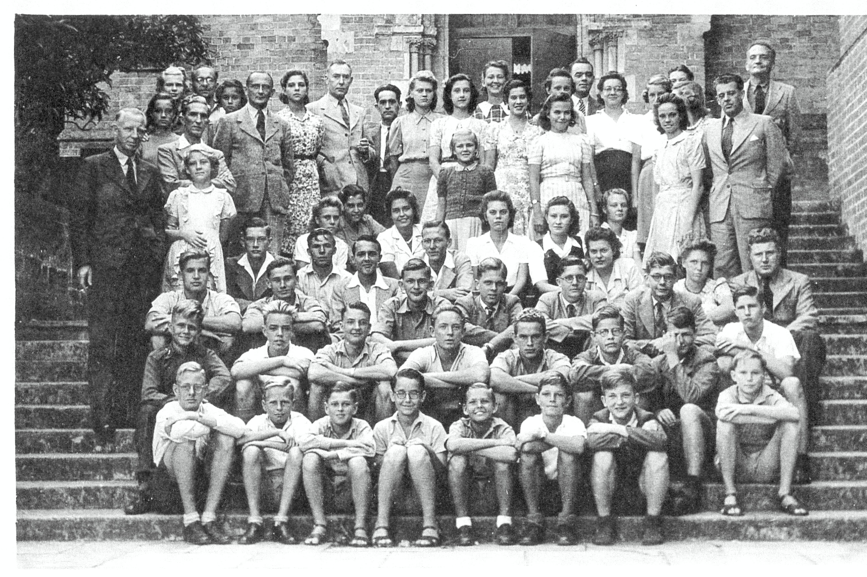
Dutch temporary high school, Burt Hall, Anglican Cathedral,
St. Georges Terrace. Perth

Slide 12
Fairbridge Farm School, Pinjarra accommodated the younger Dutch refugees
Established in 1913 by Kingsley & Ruby Fairbridge
As an orphanage for a child migration scheme to teach them to be farmers and domestics.
1,000 children sent after WWI
1,520 children sent after WWII
Most WWII arrivals were not orphans at all.
See Film Oranges and Sunshine

Slide 13
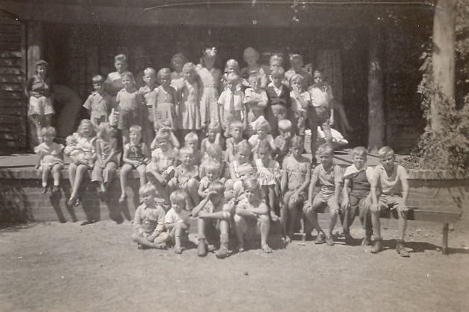
Young (feral) Dutch refugees were sent to Fairbridge Farm School for rehabilitation & education
Sometimes, it accommodated up to 400 Dutch children.

Slide 14
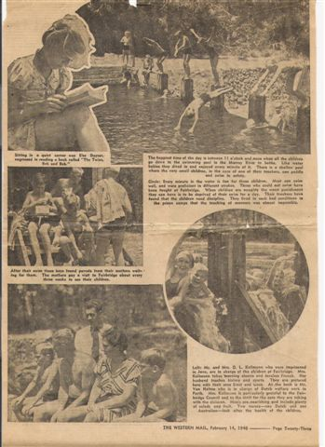
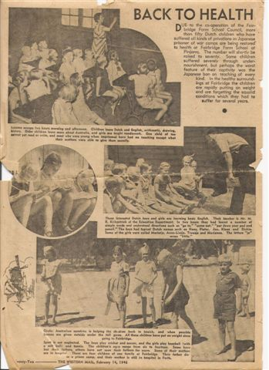
Rehabilitation
Notes:
Western Mail

Slide 15
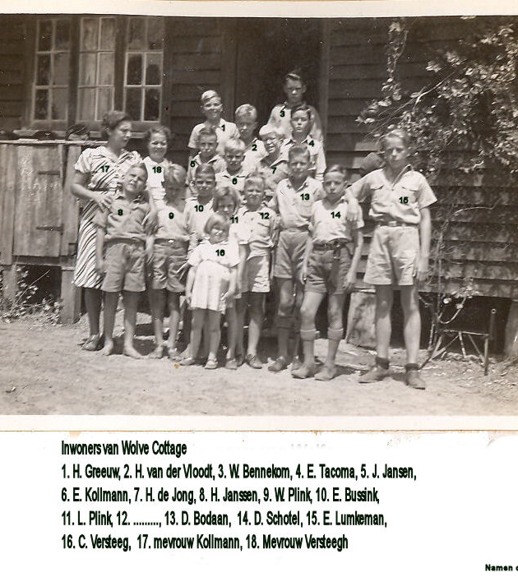
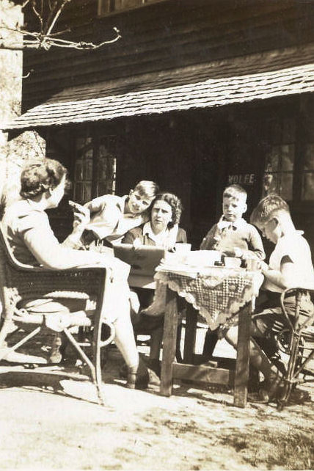
Fairbridge Farm School, Pinjarra cottage accommodation

Slide 16
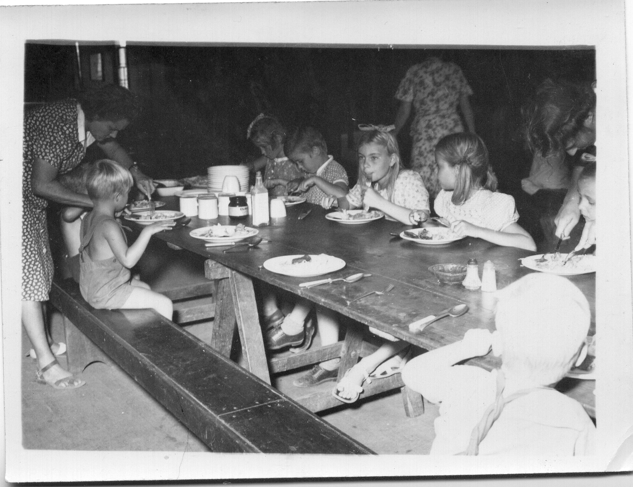
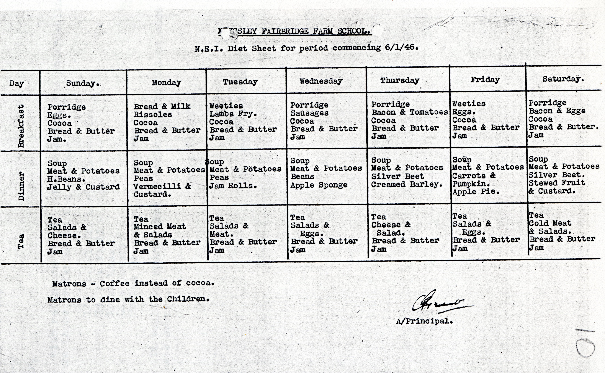
Discipline Many of the children had never sat at a table or used utensils to eat.
Food wonderful
Food!
Rituals

Slide 17
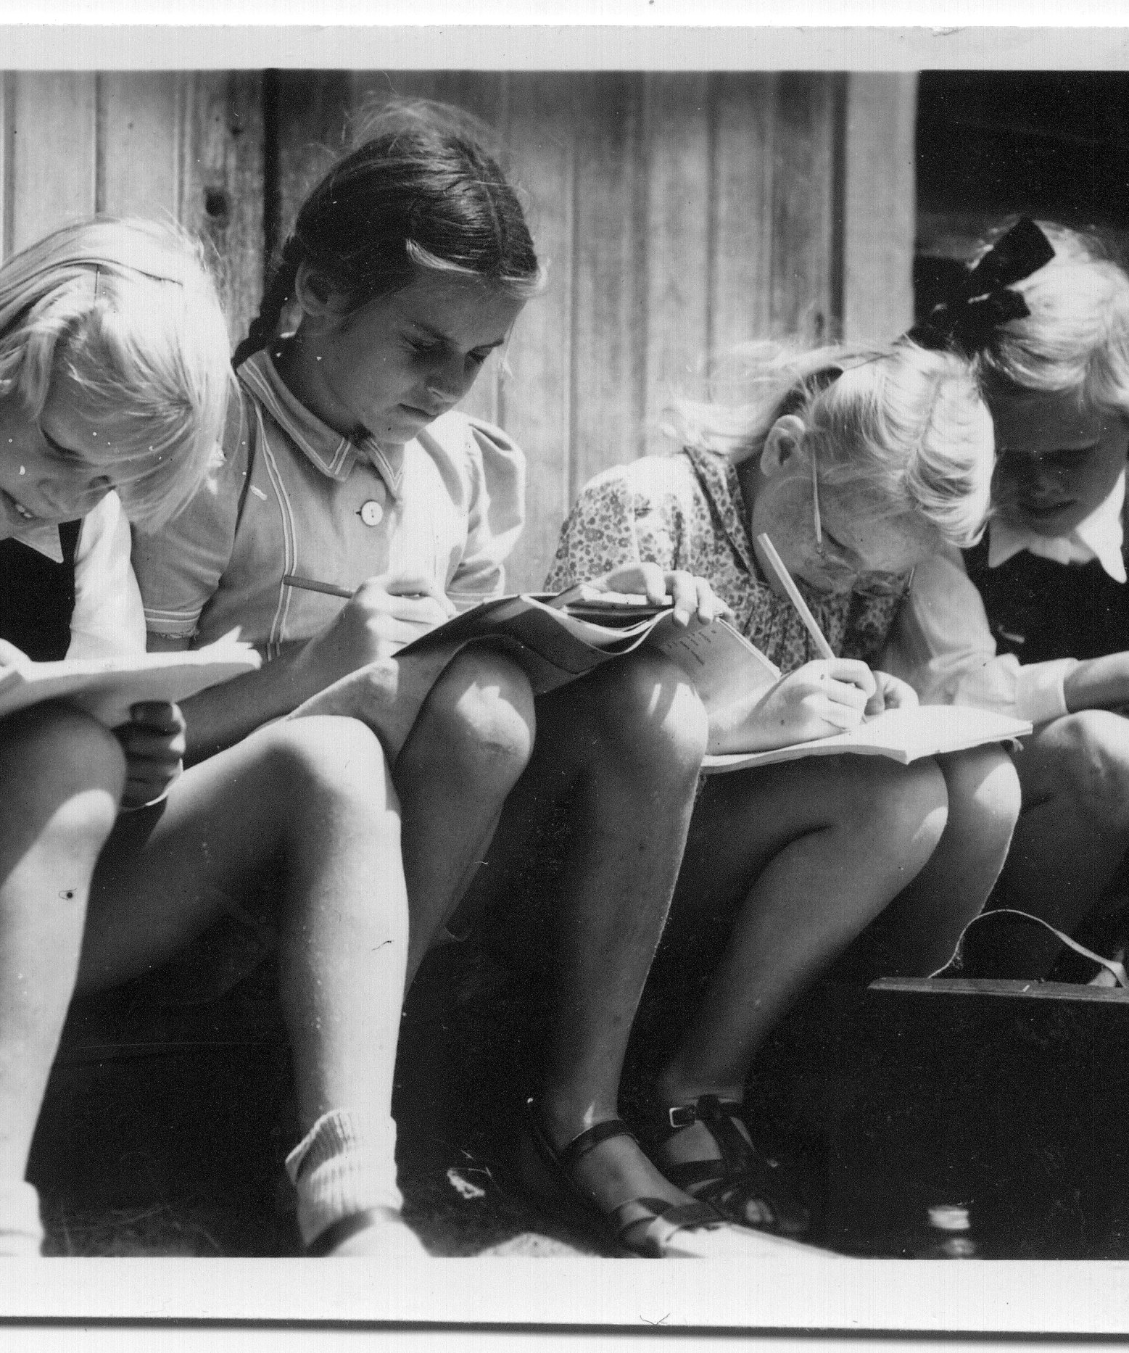
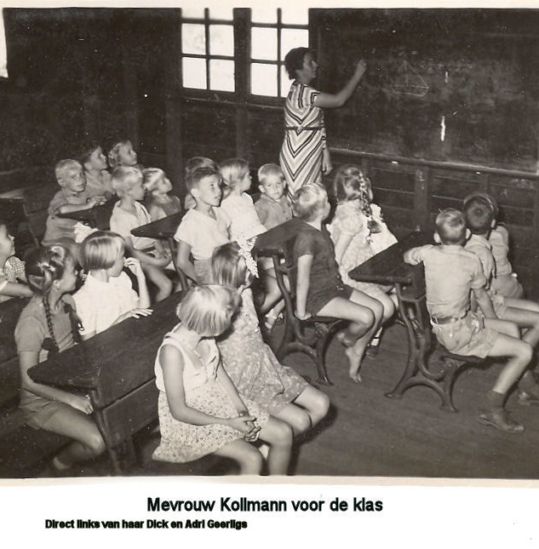
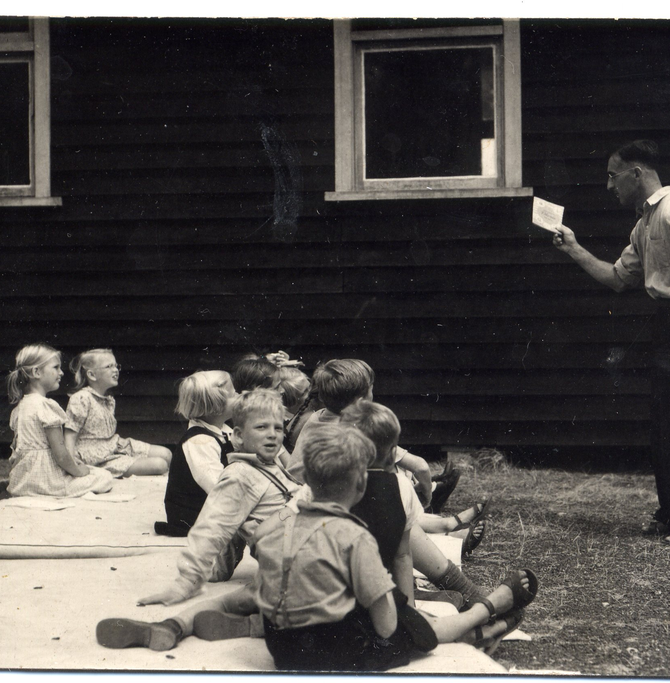
Education
The younger children had never been to school. At Fairbridge they were brought up to speed on Dutch curriculum including English lessons from Mr Patrick and Dutch lessons from Mrs Kohlmann.

Slide 18
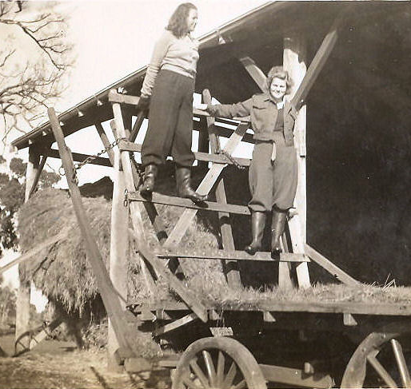
Childhood diseases mumps and measles
Nora Lumkeman
…the mumps broke out at the school and I, being 21 years of age and having some experience with sick children in the internment camp, was asked to come to nurse the little patients. Afterwards, I became a cottage mother together with Ella Bone a WA girl. I also gave gymnastic lessons and Ella played gusti with the children — a sort of Indonesian rounders. We had a good time together full of laughter.
Those were days in paradise!

Slide 19
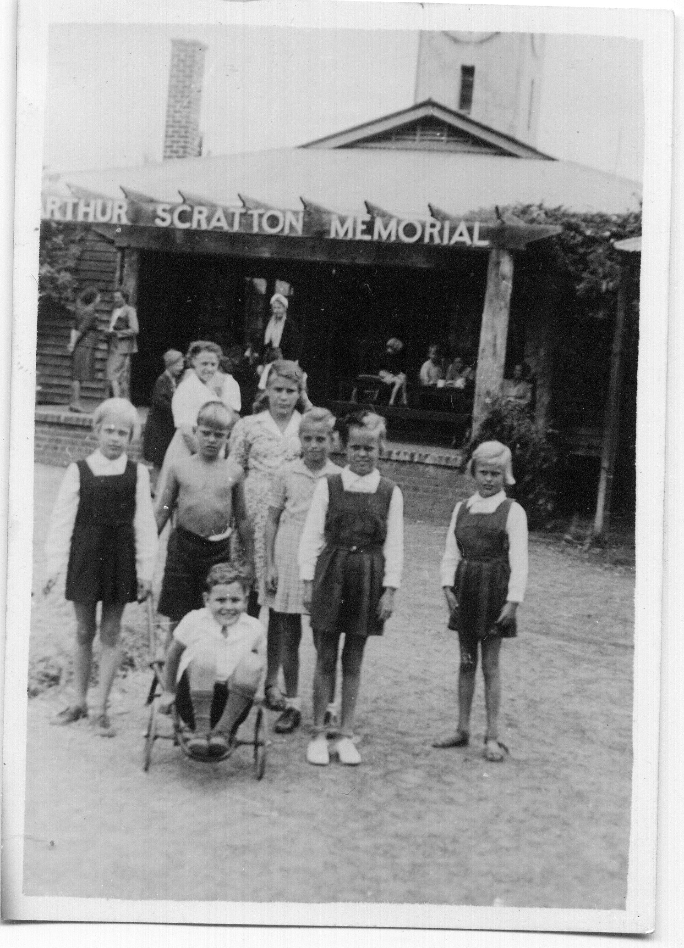
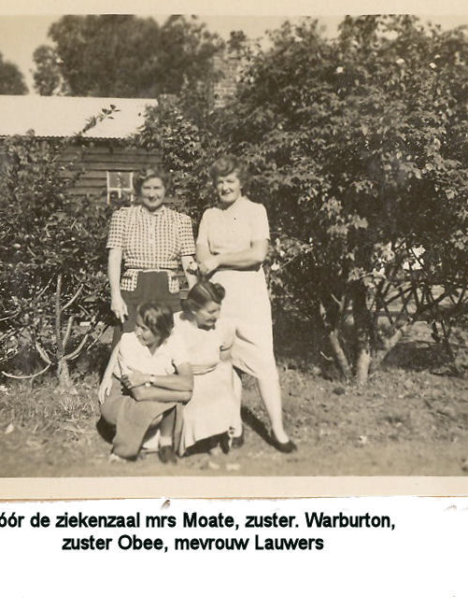
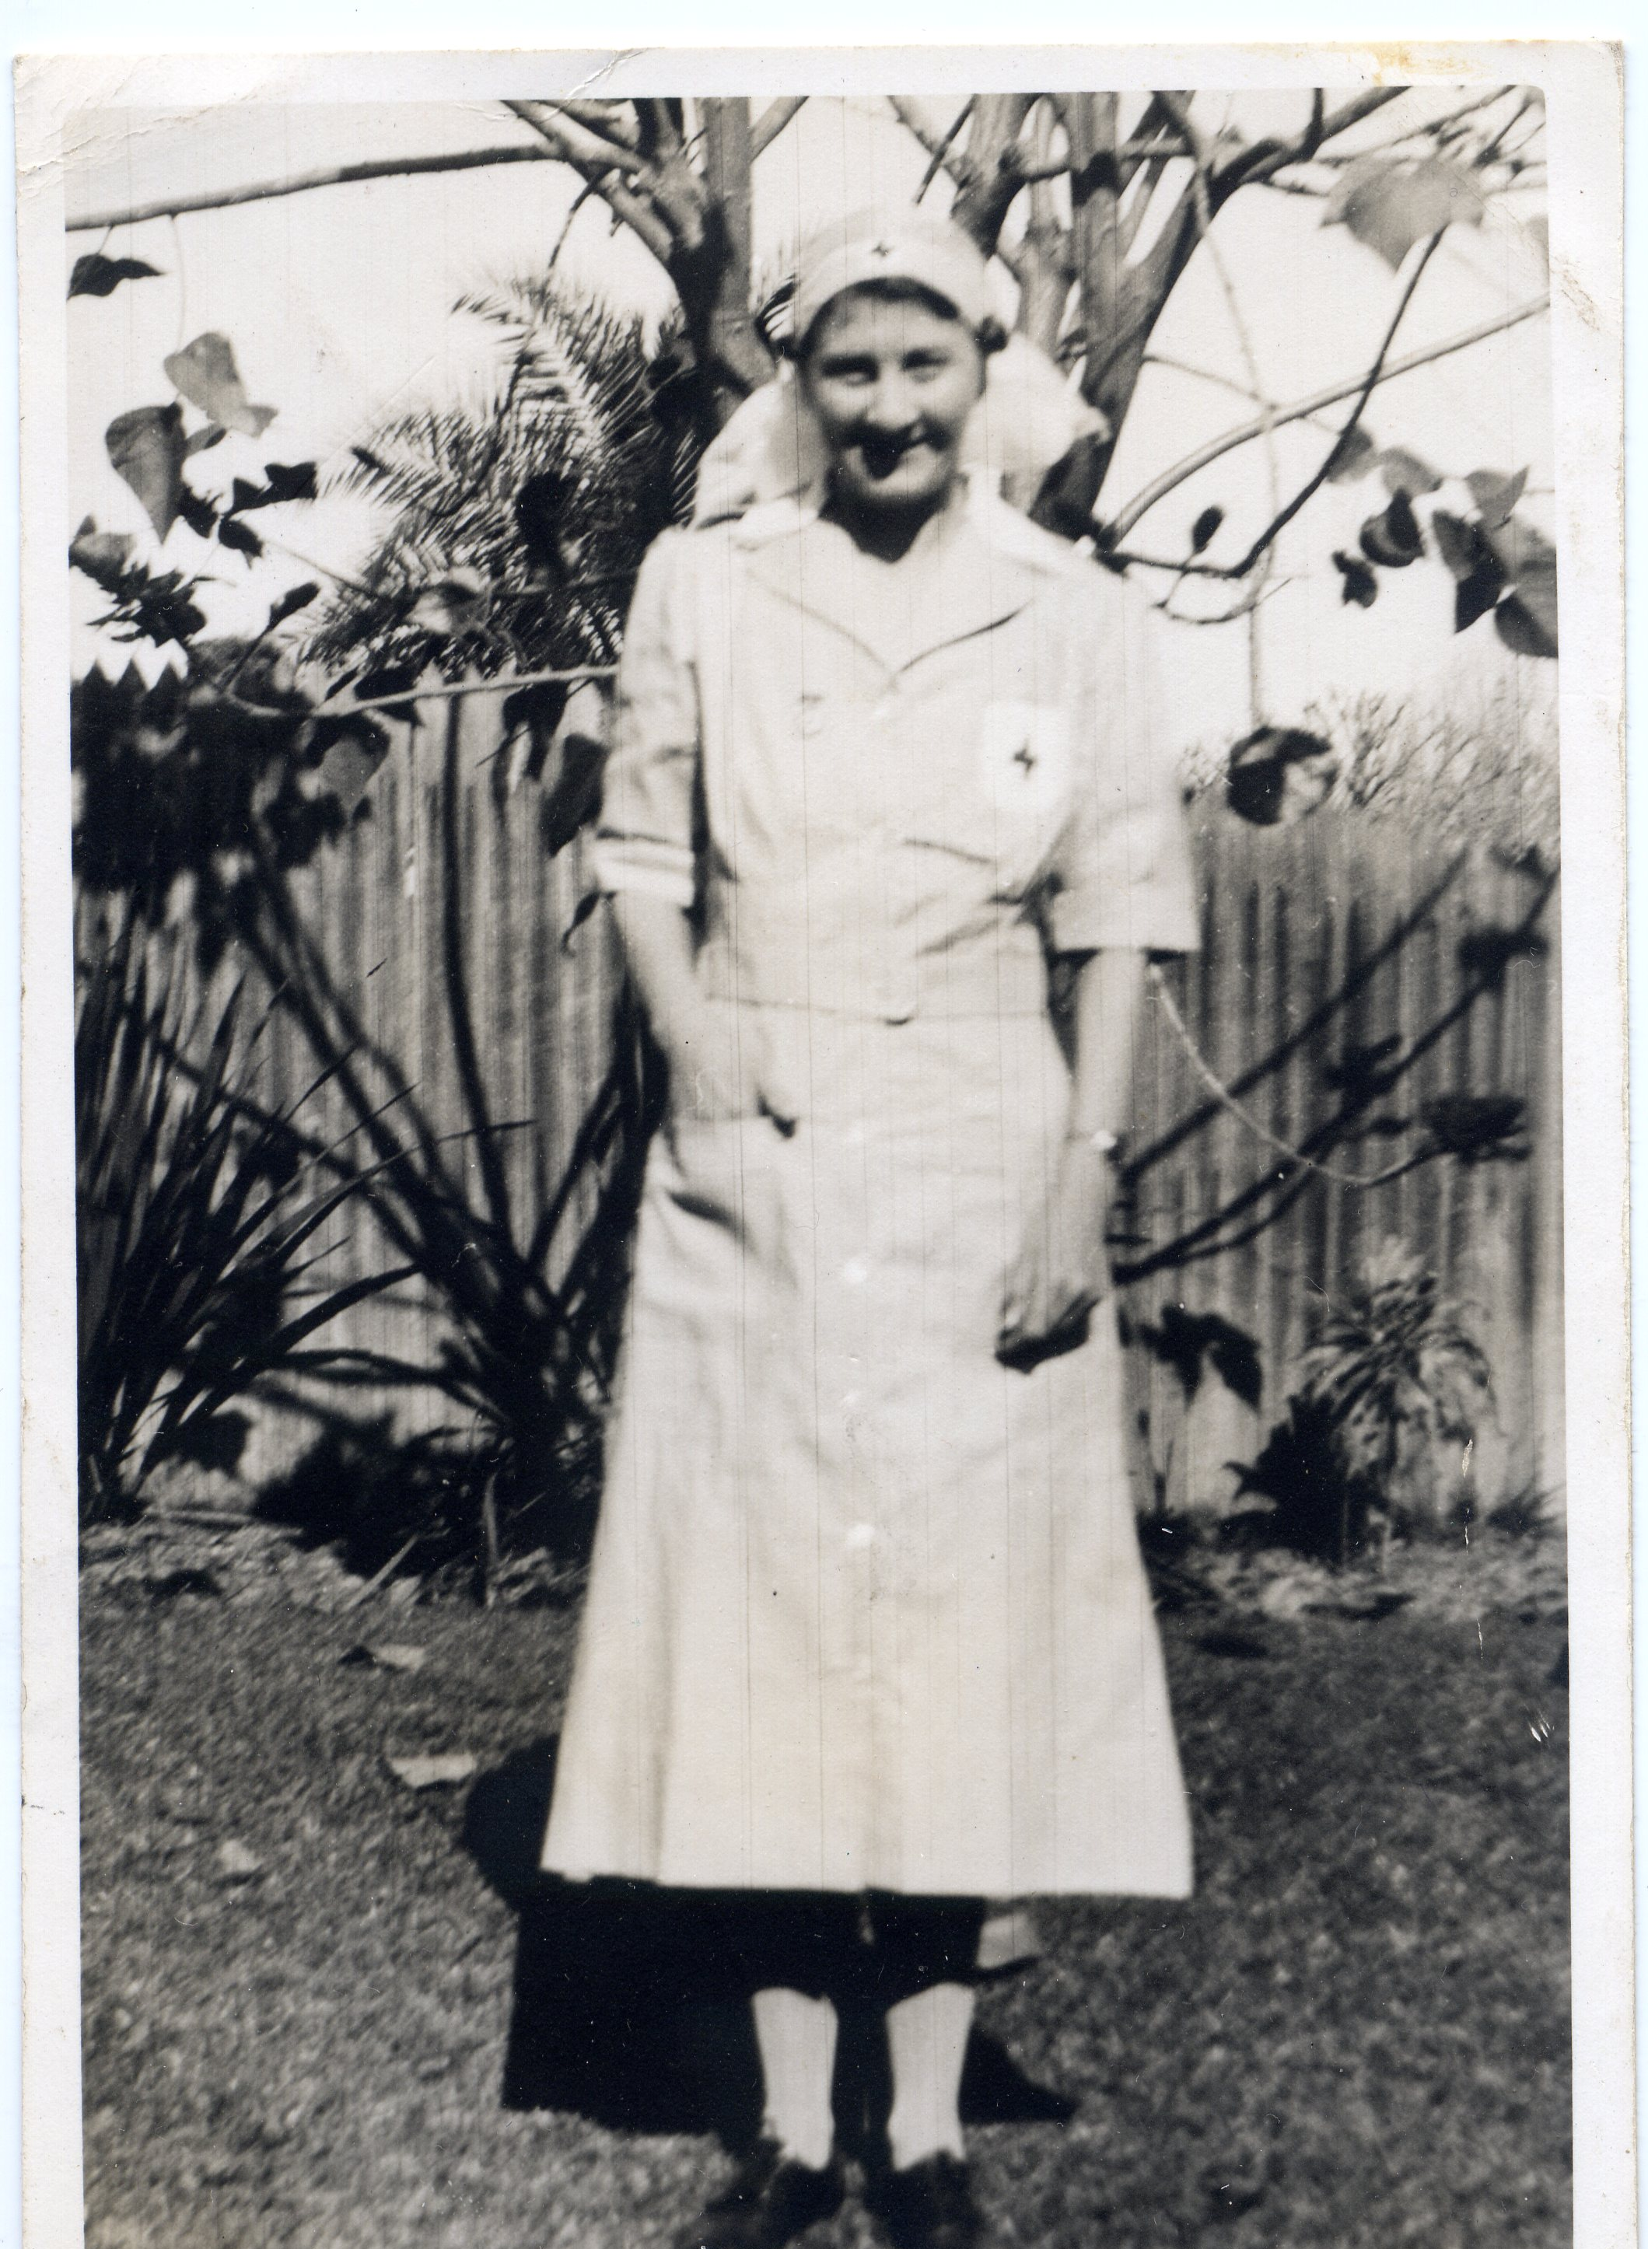

Severely depleted and traumatized children needed a great deal of medical attention.
Many were also having nightmares and bedwetting

Slide 20
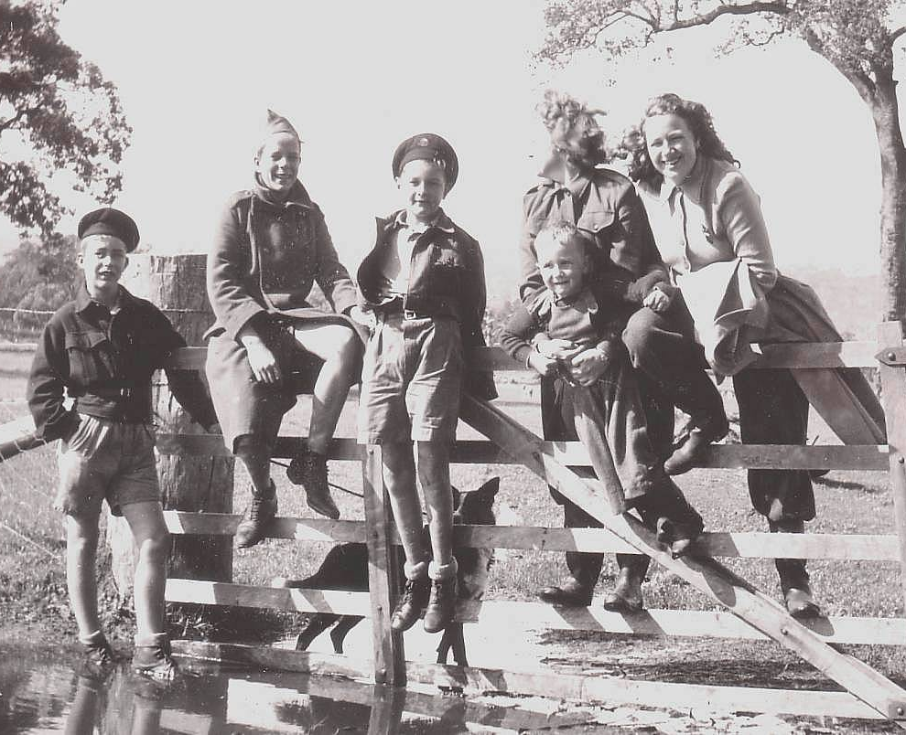
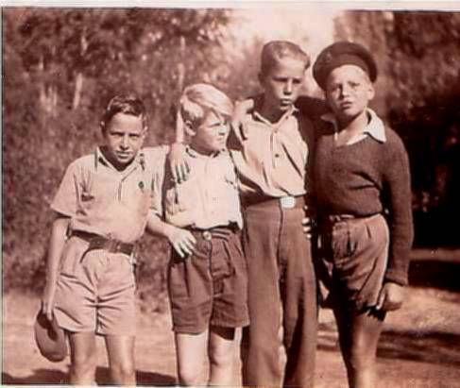
Japanese “boy’s camps” survivors at Fairbridge
Donald Schotel & other Dutch boys who survived the Boy’s Camp rehabilitating with mates at Fairbridge Farm School.
.

Slide 21
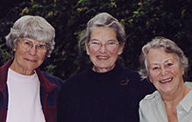
The family of Dutch Fairbridgean Anneke Slik had to face the tragic loss of a son and brother: …just before Christmas we got the message that my brother [interned in a boys’ camp] had died. . I remember people coming to my [bereft] mother, and I feeling forlorn, kicking stones outside because nobody [seemed] to care about how I felt!.
In NL their stories were silenced
Winnie, Adri & Anneke 2006

Slide 22
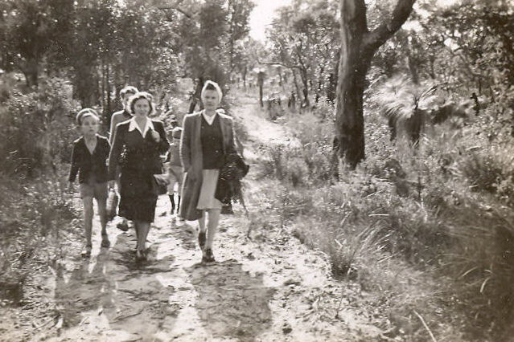
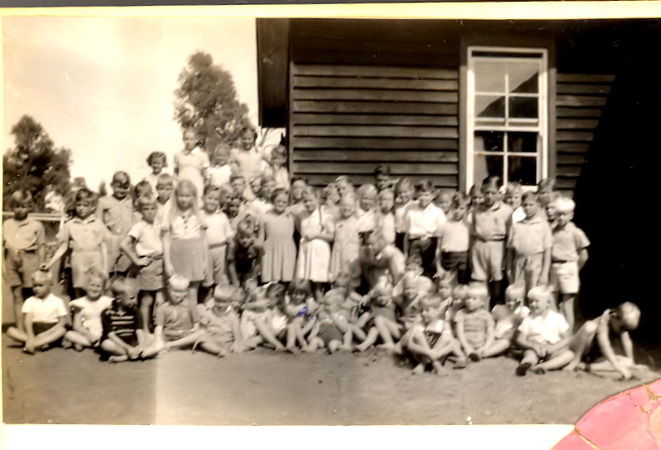
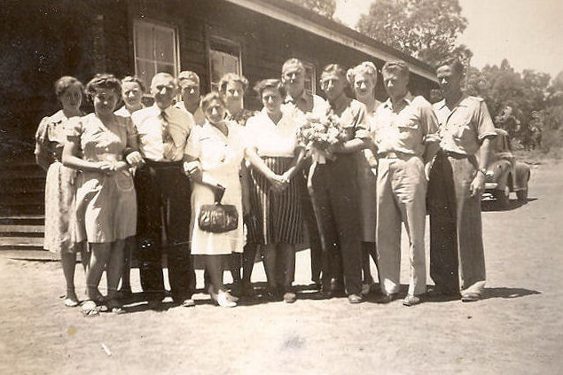
Some parents living in Perth come to Fairbridge to visit their children every three weeks. Parents with teaching skills resided at Fairbridge to take the classes needed to prepare the children for when they were repatriated to NL or the NEI.
Visiting
parents
The children were way
behind and needed
specialised teaching.
Parent who were teachers

Slide 23
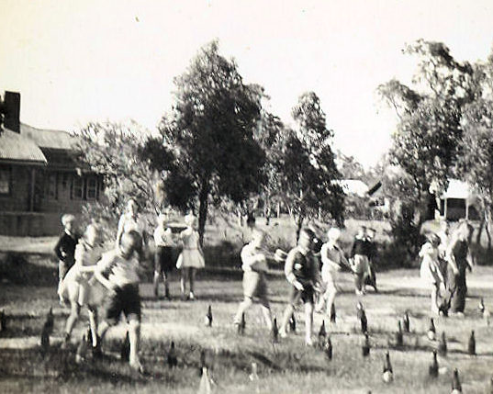
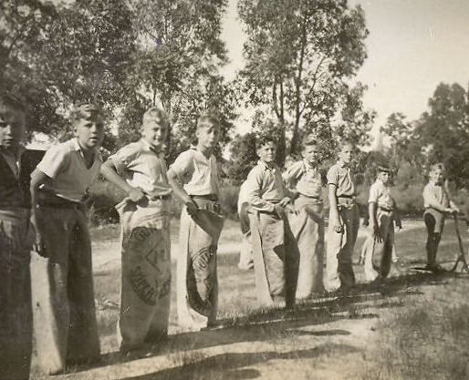
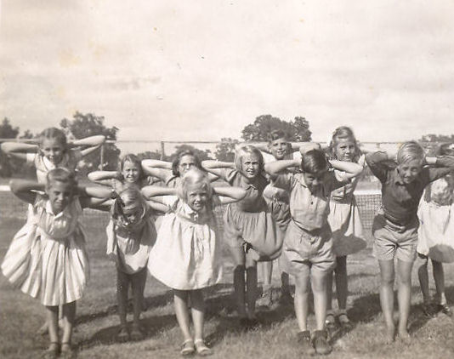
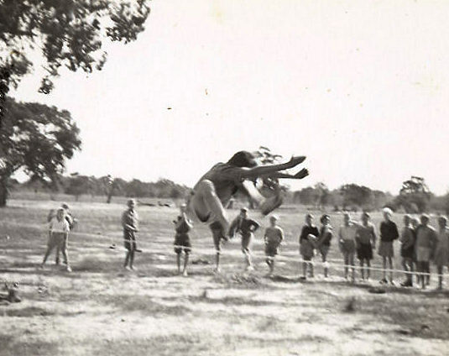
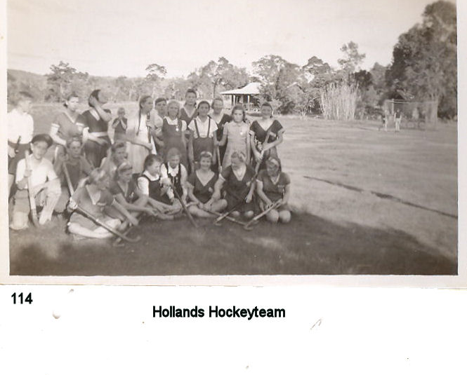

Sport Days

Slide 24






Fairbridge provided carefree fun!

Slide 25


Cuddling the farm animals aided rehabilitation.

Slide 26



There were outings to the Karri Forest and beaches at Mandurah Some kids got Australian Malvern Star bikes
Notes:
Karri Forest Pemberton

Slide 27



Leaving Fairbridge

Slide 28

Children in Wartime
The Second World War was a watershed when civilian victims were as numerous as combatants. In this carnage, more children were killed or orphaned than at any other time in history.

Slide 29

Donald Schotel, wrote:
Anyway, for myself my stay in Fairbridge and generally my stay in Australia immediately after the war will always be remembered as an arrival from hell to heaven; and to my death I will never forget what Australia has meant to me.
,
In summing up, Ernst notes that while WWII, POW camp life, loss of home and country, had left him feeling his was a ‘fragmented youth’. His overriding description of Pinjarra is:
… happiness, happiness, happiness again. Freedom. These are two things that I remember…. and Australia…was a new beginning - and it always will [be], Yes, I am always, still very grateful for that, to the Australians. Yes. an unforgettable time where without really noticing, the normal tenor and discipline of everyday life was reinstated!
Els Duyser, artwork 1945:
Netherlands Youth Bloom Again at Fairbridge.

Slide 30


2006: Ella Bone reconnects with Fairbridgeans. 2018: Prinsen Gracht, Amsterdam luncheon. 2025: Not many Fairbridgeans left. We need to keep telling the stories of the short & long-term intergenerational impact of war and displacement.
Notes:
Although Ella was a staff member, she also describes her time at Fairbridge as one of the highlights of her life. Ella has over the last 60 years-maintained connections with some of the Dutch evacuees. She also has Dutch and Dutch East Indies ephemera, memorabilia and artefacts in her home. She also attended the Fairbridge Dutch evacuee reunion in 2006 in the Netherlands.

